Slide 1
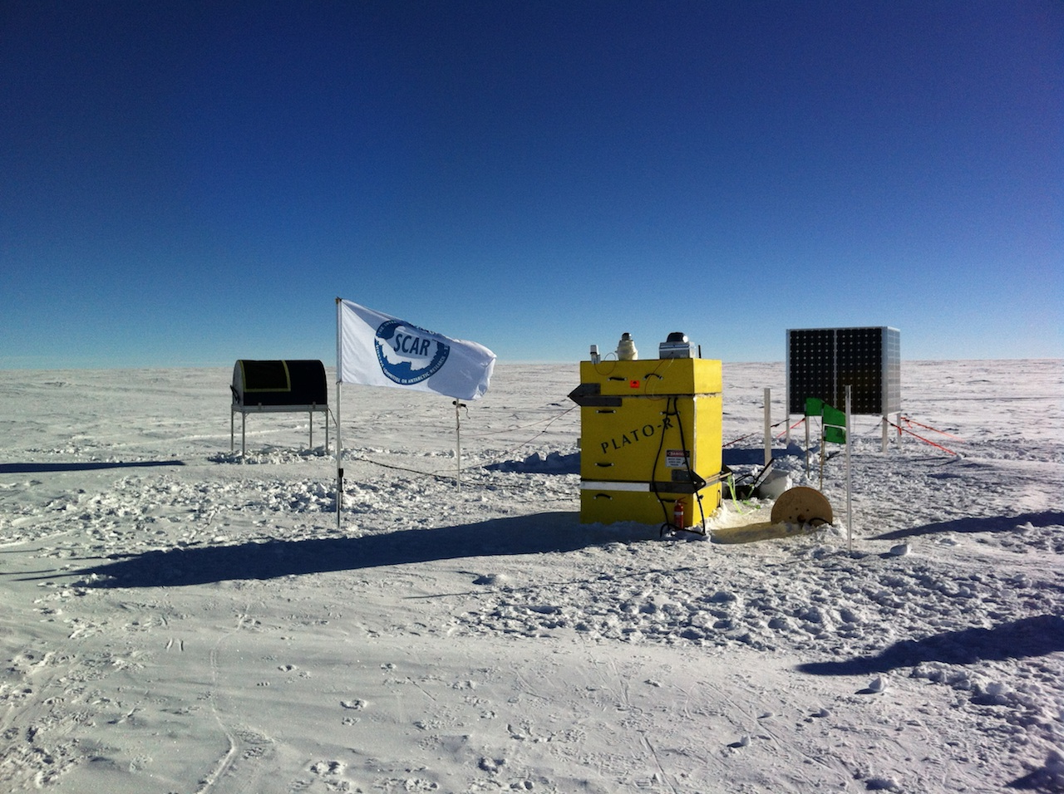
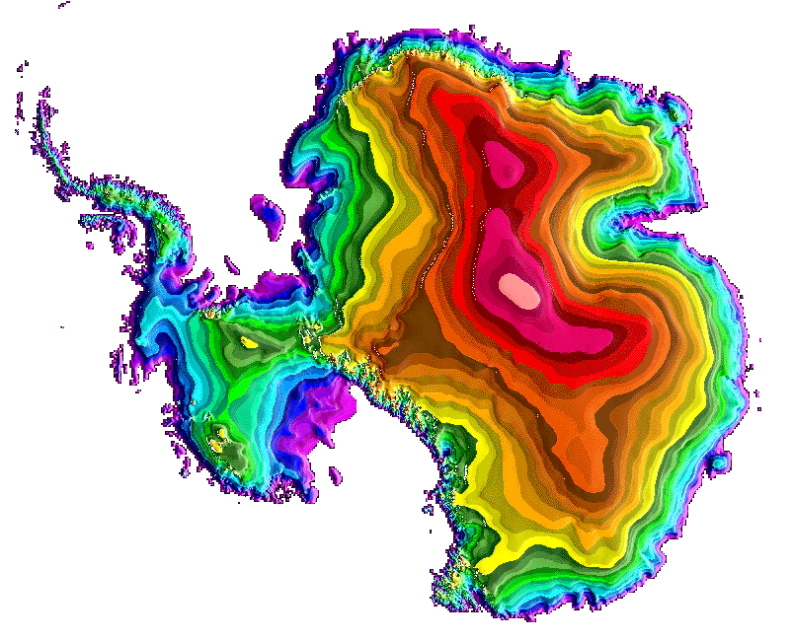
Ridge A
The summit of the Antarctic plateau is the best observing site for far infrared and submillimeter-wave astronomy on Earth.
The 0.6m aperture High Elevation Antarctic Terahertz (HEAT) telescope operates robotically from the summit ridge and delivers spectroscopic data from 150-500 um wavelength. The site is 5-10 times drier than the ALMA site.
( http://soral.as.arizona.edu/heat/ )

Slide 2
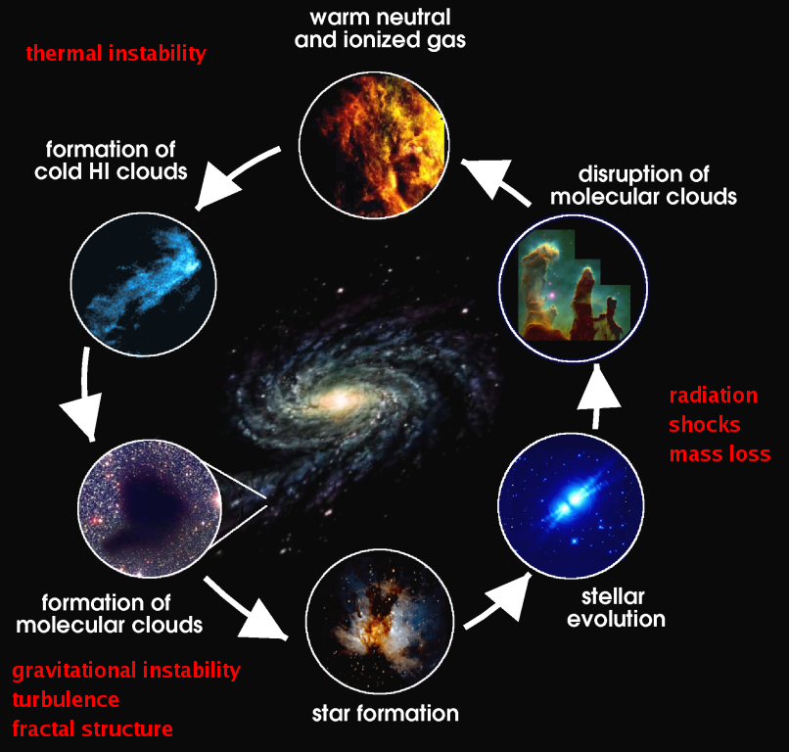
Galaxies are fundamentally transformed by the cycling of matter between gas and stars.
Much of this cosmic life cycle is not observed at traditional O/IR or radio wavelengths
Best probed by far-IR lines of C, N, O
Observations require effectively no intervening water vapor!

Slide 5
HEAT’s deep spectroscopic surveys (left) are finding pervasive, diffuse molecular clouds not seen in existing surveys of CO and HI (right).

Slide 6
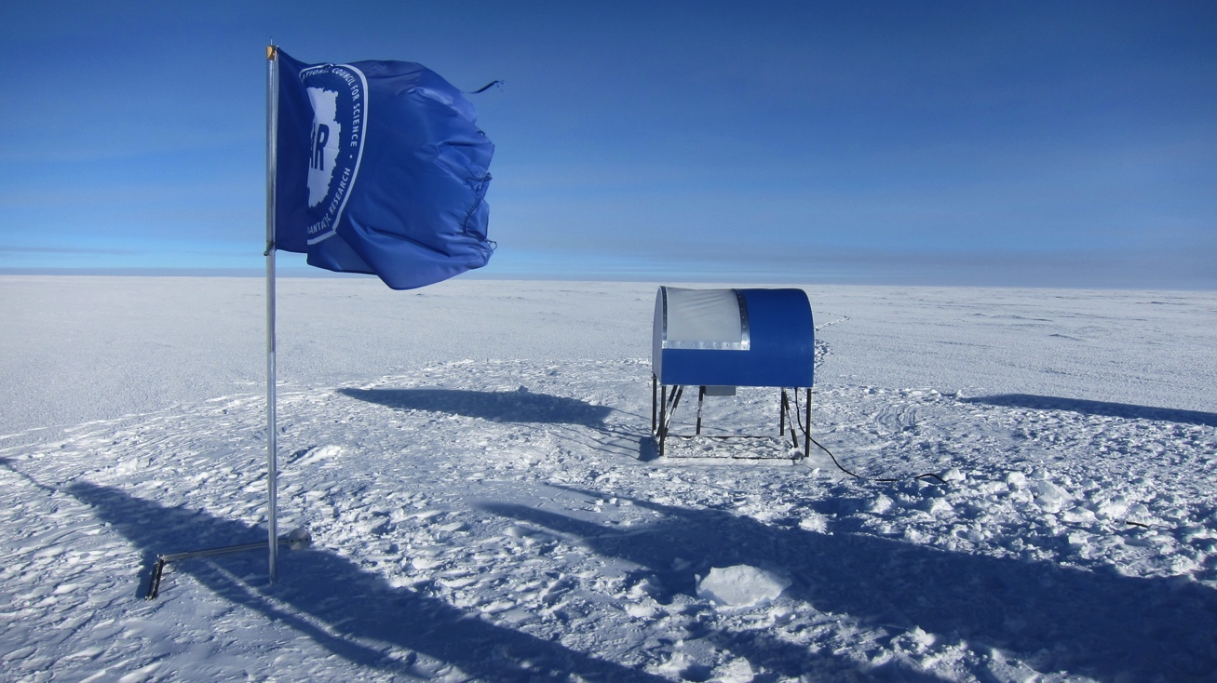
HEAT main results to date
The summit of the Antarctic Plateau is by far the best place to do submillimeter-wave astronomy (5-10 times drier than the ALMA site, about 20 times more observing days for frequencies >1 THz (<300 um)
HEAT’s spectroscopic mapping of atomic carbon shows a surprising amount of pervasive, diffuse molecular gas. Almost 40% of Galactic molecular cloud mass has been missed by existing surveys.
Hundreds of clouds are being comprehensively analyzed in 3D for the first time, and over a dozen candidate regions where clouds may be forming have been found.
HEAT lays the foundation for high-power autonomous observatories in Antarctica, opening up new atmospheric windows and low-cost capabilities for wide field mapping and interferometry at ALMA frequencies and higher

