Slide 1
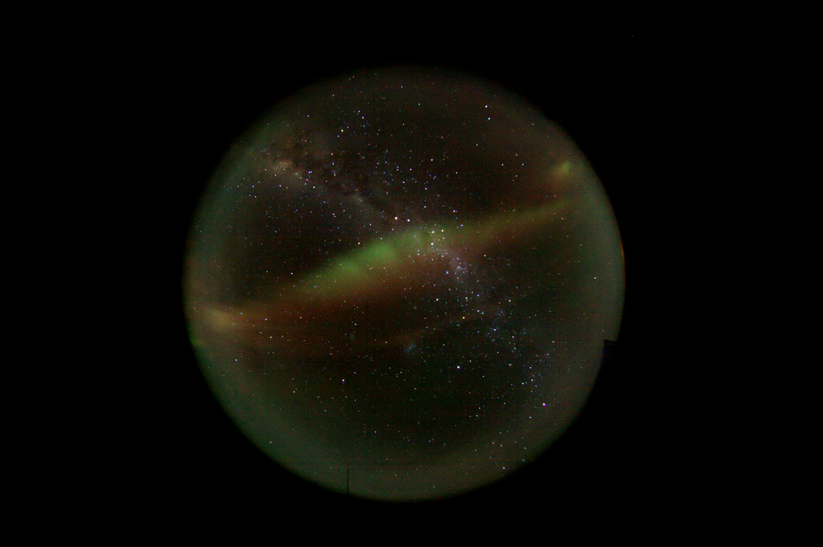
The HEAT Galactic Plane Survey
HRCAM3 image from Ridge A
- Surveying ~100 deg² of the midplane as seen from Antarctica
- Initially in [CI] J=2-1 at 809 GHz (370 um)
- Some mapping in CO J=7-6 at 806 GHz
- Focused mapping in [NII] and CO J=13-12 at 1.5 THz (200 um)
- Continued push to achieve the [CII] line at 1.9 THz (158 um) in next servicing
- Complemented by Mopra at 100 GHz, Supercam/APEX at 350 GHz, STO-2 at 1.9 THz

Slide 2
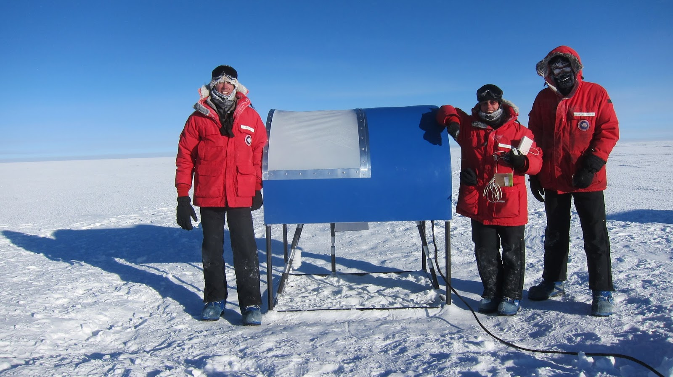
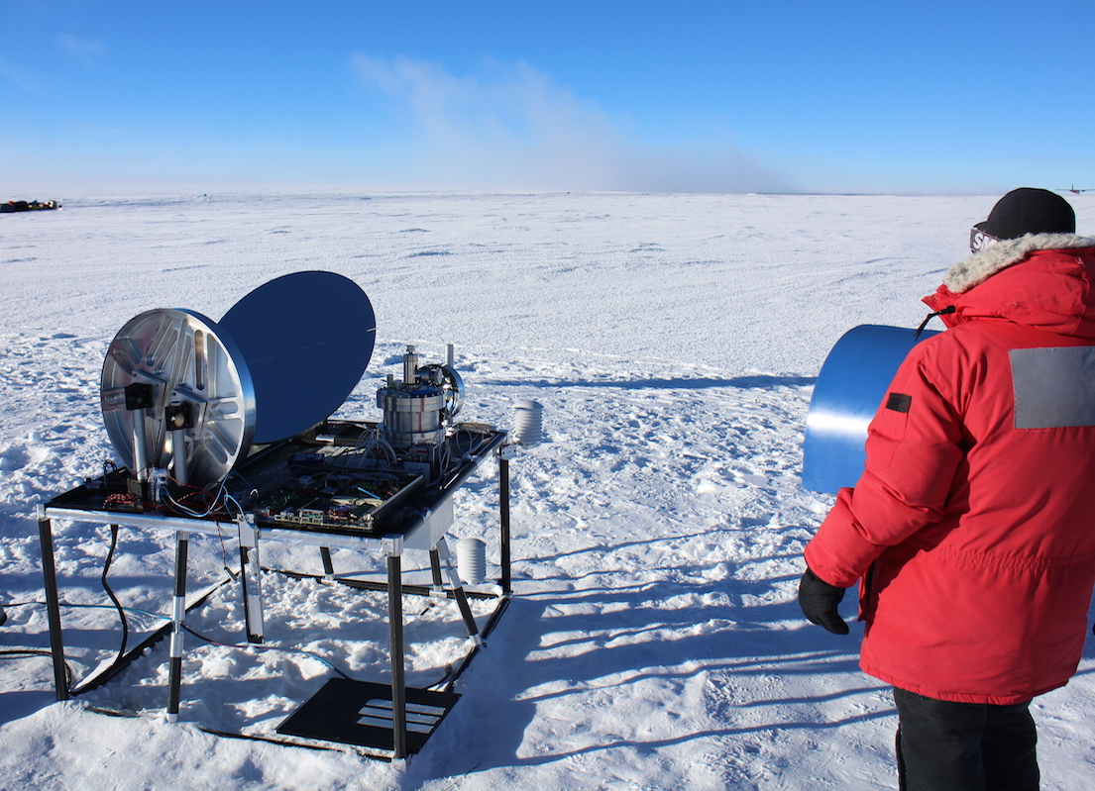
Large Scale Surveying with a transit telescope
Off-axis Gregorian 0.6m telescope with single steerable mirror in elevation
Fibreglass dome with 2-5 mil PTFE window
Frozen PI
Cryostat &
M3 mirror
150-200W power dissipation including cryocooler
Sky rotation provides “azimuth drive”
Survey strategy
- Main beam of telescope is aimed geographic North
- Observe Galactic plane whenever it passes through the field of view
- Perform pointing observations, data reduction & skydips during downtime
- Single objects are only visible once per day if below ~60 deg elevation
- Above 60 deg elevation, can observe objects twice per day (N & S transits)

Slide 3
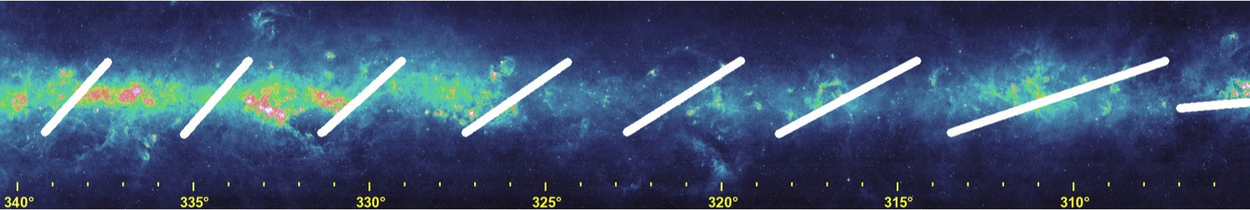
Implications of Survey Strategy
- Elevation is held constant during On-The-Fly (OTF) maps (i.e. drift scanning). This leads to mapping strips of constant declination on the Galactic Plane, which are gradually filled in as the survey progresses.
- Accumulation of adequate signal-to-noise on any particular target takes weeks! Systematics that must be tamed to produce a final dataset over long time spans.
Example: Desired rms noise per 1 km/s spectral bin is, say 100 mK. Assume observing zenith angle is 35 degrees.
In median winter weather with PWV=0.13mm, 809 GHz sky opacity is 0.4 and receiver noise temperature at 50K is 1450K DSB. Total integration time needed: 700 sec, or ~35 days of passes!
Naturally, we are observing 24/7 and thus are accumulating data over ~15 regions each day. 1 deg² of the Galaxy total is mapped every ~10 days, but exact rate is very sensitive to precipitable water vapour.

Slide 4
Survey products currently available (DR1)
Upcoming data release DR2
Released May 2014 based on data products from the 2012 and 2013 seasons
- 9 Galactic strips, each close to 1 deg² in scope, from G300 to G343
- 2 maps of regions of interest around G328 and G332, 1 deg² each
- Emphasis on [CI] J=2-1, though some 2012 data in CO J=7-6 is available
HEAT hardware and data system from 2014 is expected to arrive in Tucson on Thursday (16 April 2015). Data processing of raw products will generate our next data release in May 2015 based on 3 years of data.
- 12 Galactic strips, most >1 deg² in scope, from G280 to G347
- 2 maps of regions of interest around G328 and G332, 1 deg² each
- Emphasis on [CI] J=2-1, though some 2012 data in CO J=7-6 is available
- Brand new THz data of selected high mass star forming regions in CO J= 13-12 at 1497 GHz and [NII] at 1461 GHz.

Slide 5
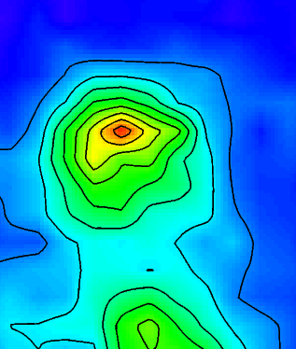
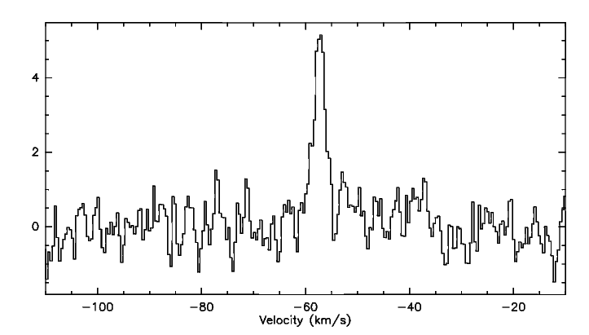
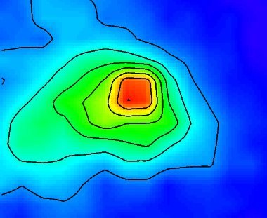
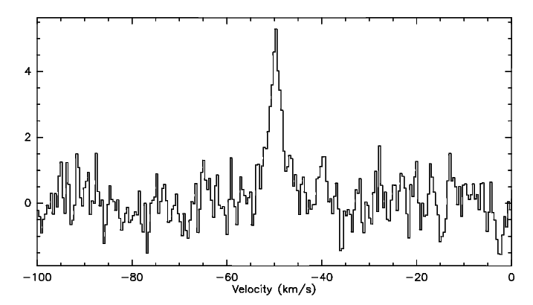
GL 4182
CO J=13-12
1497 GHz
T(K)
HEAT observations at 1.5 THz, from downlinked reductions
GL 4176
CO J=13-12
1497 GHz
T(K)
3’

Slide 6
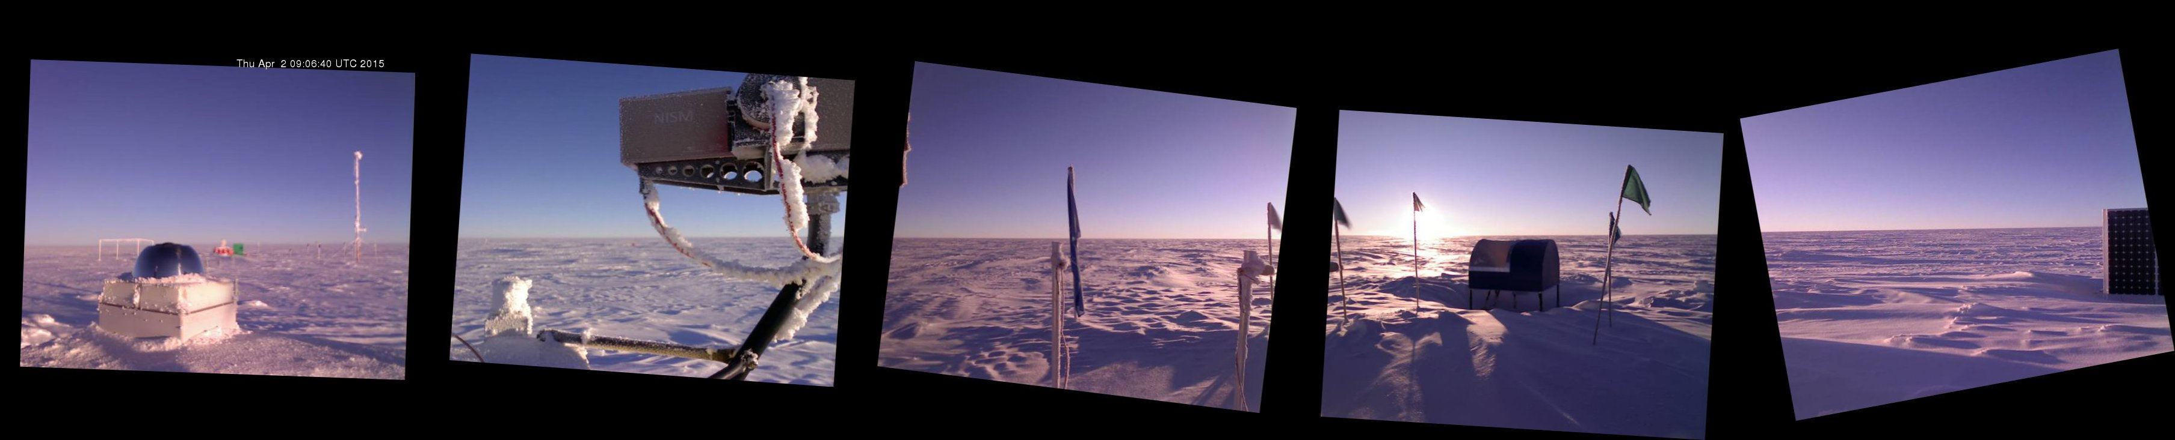
2015 Observing Season
1 PM local time, 2 April 2015
Temperature -70C, pwv = 0.11 mm
As of April, good THz weather conditions are settling in and observations are proceeding smoothly at 809 GHz. A total of 16 strips from l=270 to l=347 are being observed, plus 2 new strips of the LMC.
Special note:
- The strip map at l=347.4 slices across the TeV gamma-ray shell of SNR RXJ1713.7-3946. First reduced slices should complete in April for quick-look evaluation.
- A new strip at l=287.5 covers the eta Carina region.

Slide 7
HEAT Development Path
Stage 1 Initial deployment Starts 2012 | Stage 2 >1 THz receivers Starts 2014 | Stage 3 4K coolers Starts 2016 | Stage 4 Interferometric capability Starts 2017
One 0.6m HEAT telescope | One 0.6m HEAT telescope | One or two 0.6m HEAT telescopes | Two 0.6m HEAT telescopes plus 1.7m AST/RO
50K receivers at 810 and 492 GHz | 50K receivers at 1460 and 810 GHz | 4K and 50K receivers at 1900, 1460 and 810 GHz | 4K and 50K receivers at 1900, 1460 and 810 GHz
Funded UA + UNSW | 2014 season funded UA + UNSW | Proposed UA + UNSW + SRON + JPL + ? | Proposed UA + UNSW + SRON + JPL + ?

