Slide 1
MAPS WFS Frontend Periscope Optical Design
Rev. 1.8
March 16, 2020

Slide 2
Overview
Due to problems with procurement of reliable X-Y-Z stages for WFS patrol field acquisition and WFS nodding, alternative options were explored.
A Periscope, an OAP Relay, and an Offner Relay design were analyzed. The Periscope design with a linear Z-stage was the easiest and best option.
This slide set illustrates the worst case full patrol field cases and how a coordinated movement of five (5) DOF is required to boresight and focus the off-axis beam onto the WFS optical axis. View this presentation in ‘Slide Show’ mode.
The Periscope is a combination of the ARIES Dichroic and a Periscope Fold Mirror (PFM)
The PFM was sized based on the ACQ channel FOV of ± 10”

Slide 3
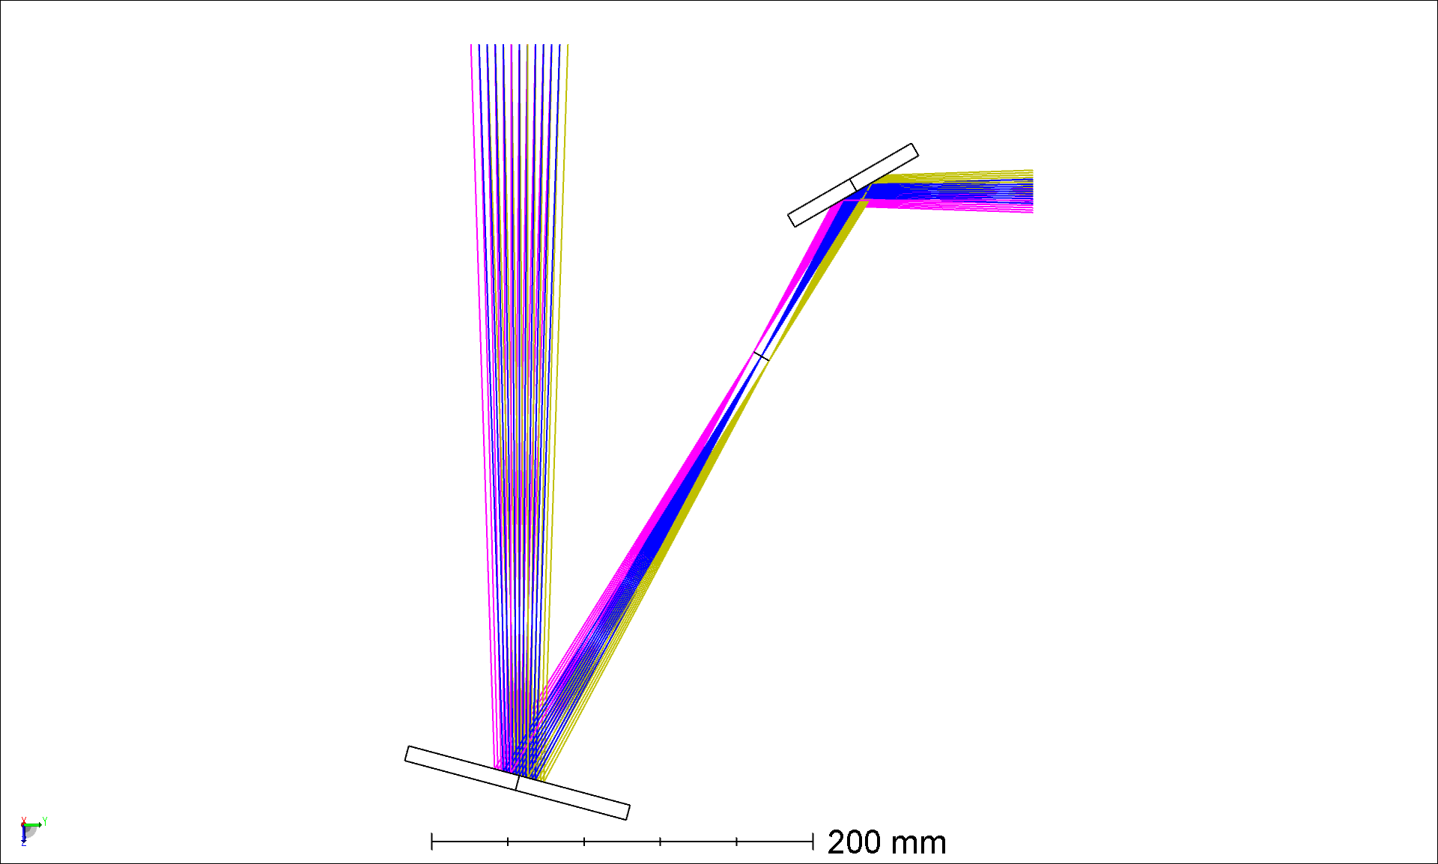
Periscope Design
3” Fold Mirror
± 10” FOV
WFS Optical Axis
~124 mm
Top Box Floor
f/15 Focal Plane
~183 mm
ARIES Dichroic
MMT1.1 ARIES1.1 Stage2.5.zmx
There is not a lot of space to insert a periscope, so the ARIES Dichroic will be used as one of the fold mirrors.
The ARIES Dichroic is located ~183mm below the Top Box floor.
Placing the Periscope Fold Mirror 100mm downstream of the f/15 focal plane provides ~124mm of vertical clearance from the Top Box Floor for optical mounts and the breadboard.

Slide 4
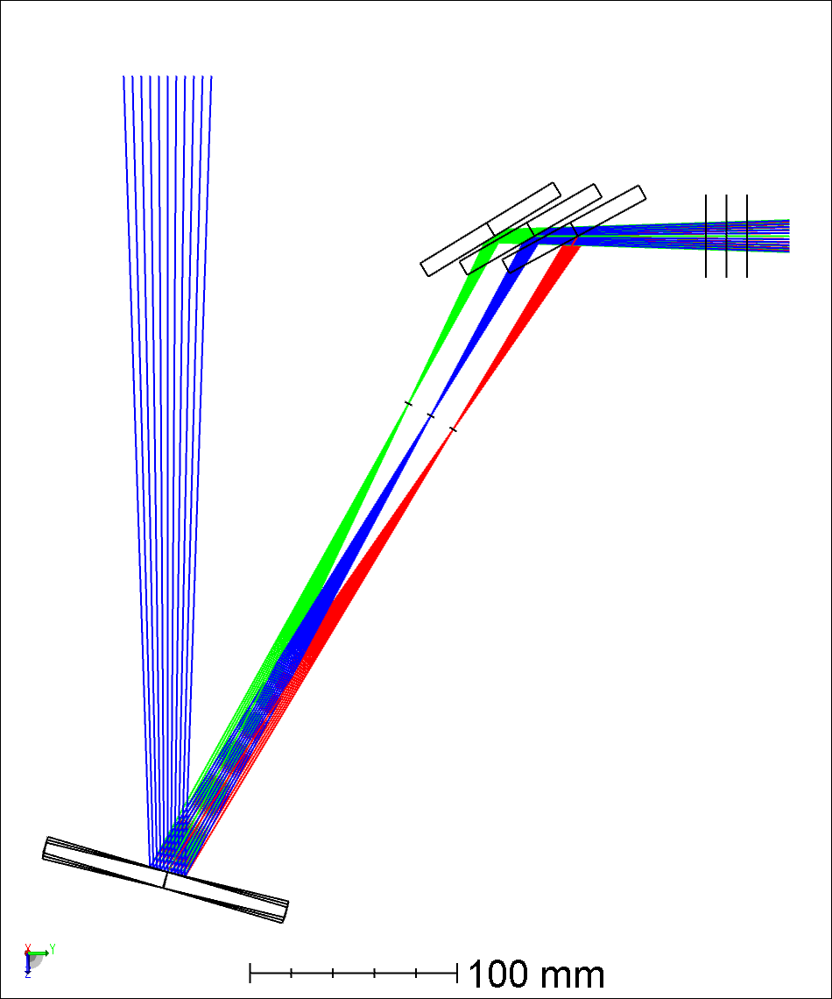
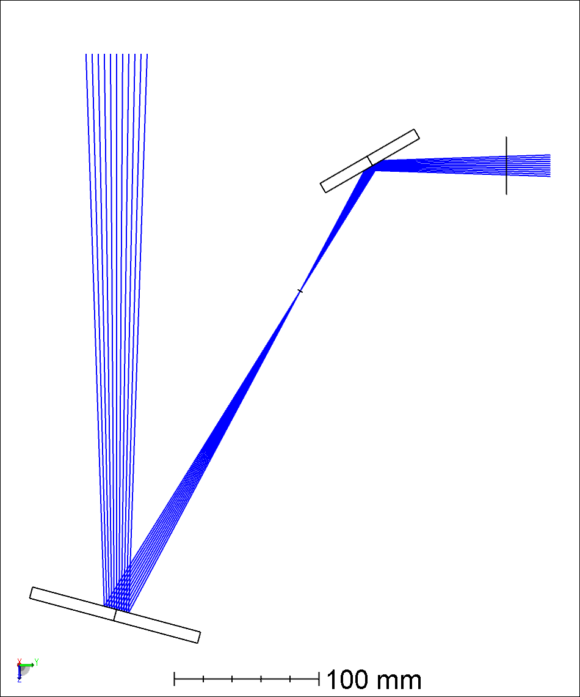
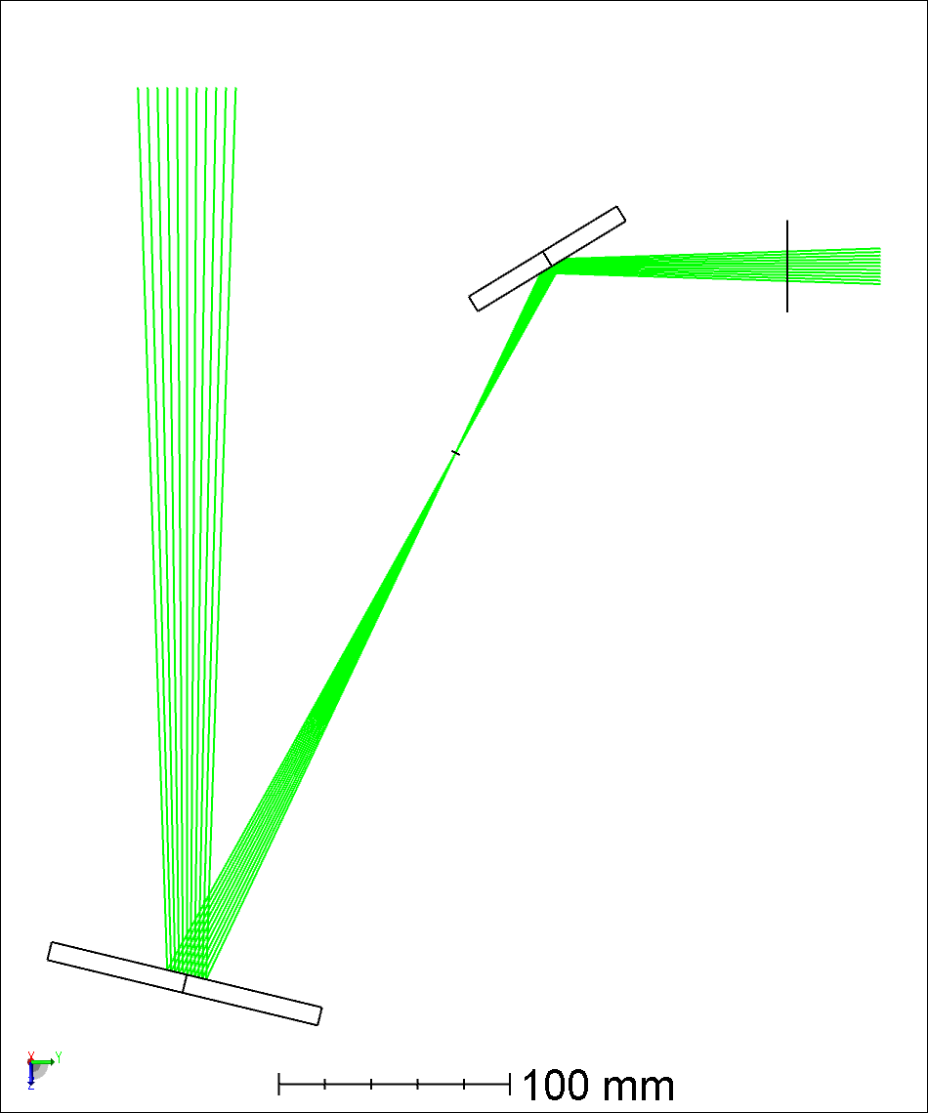
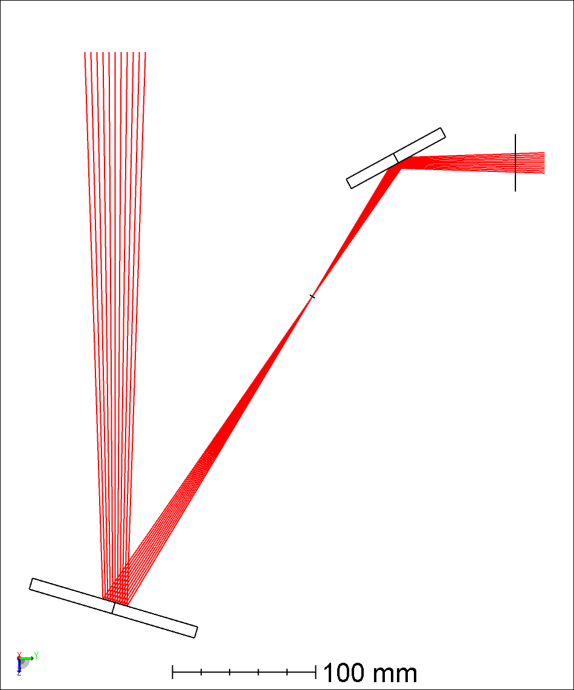
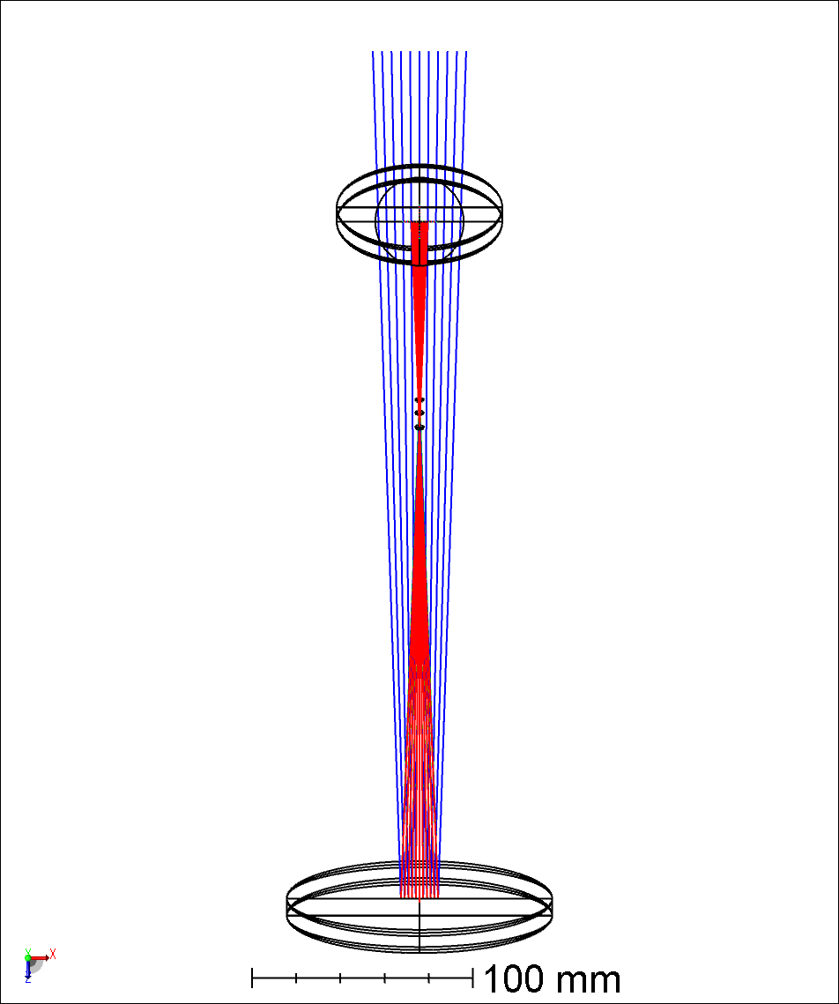
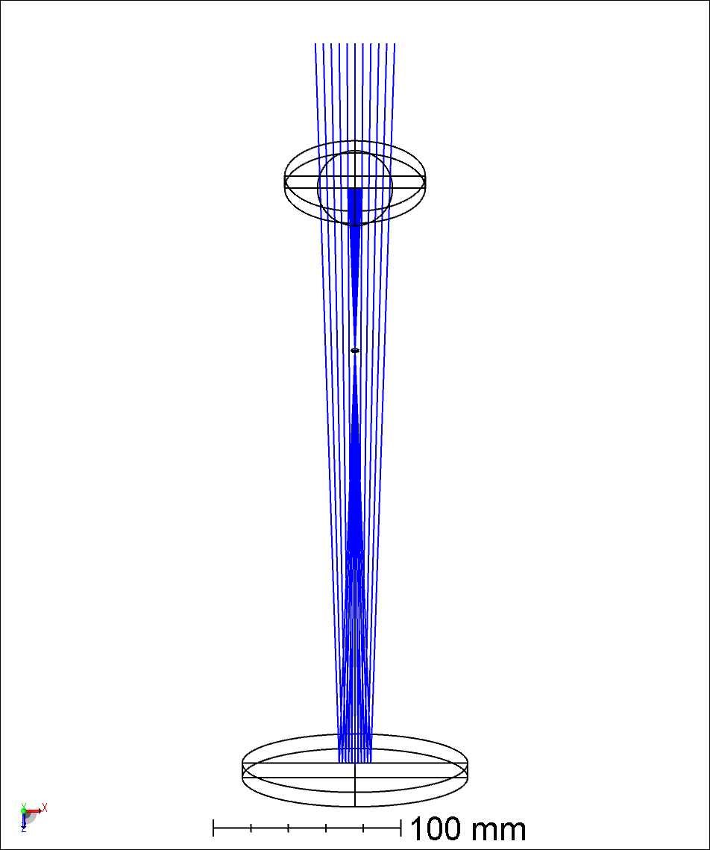
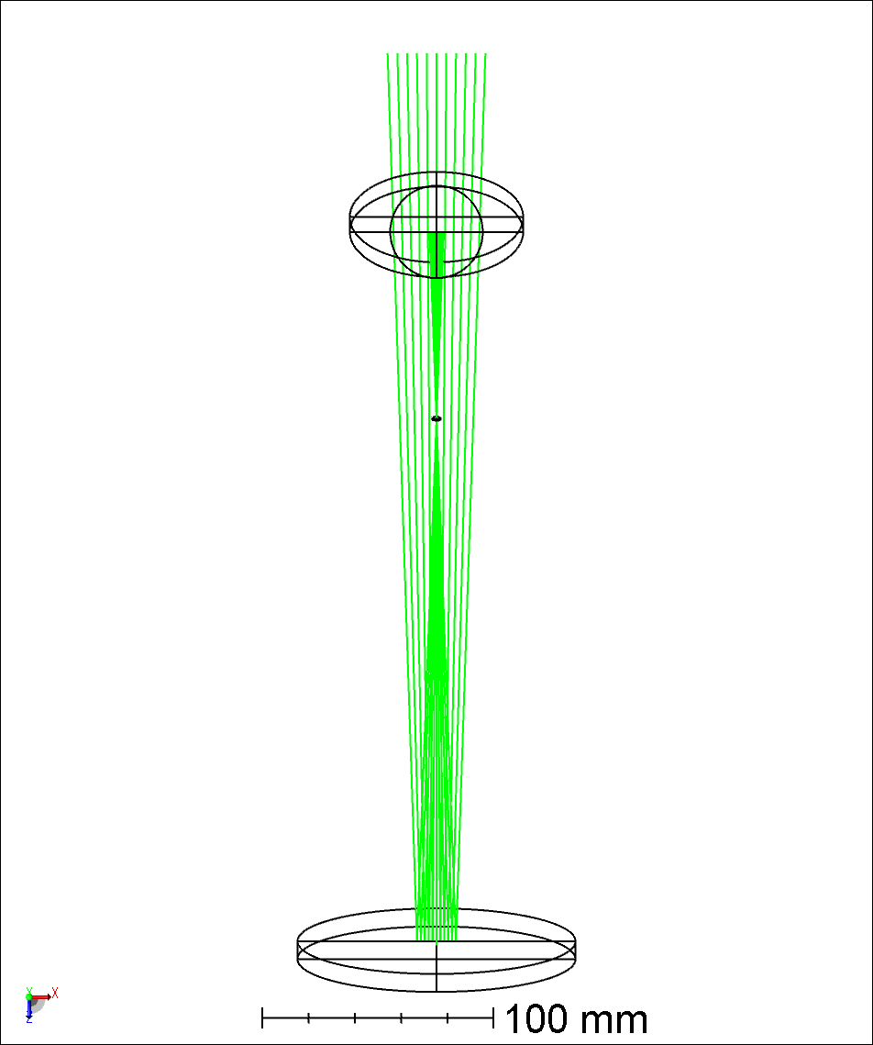
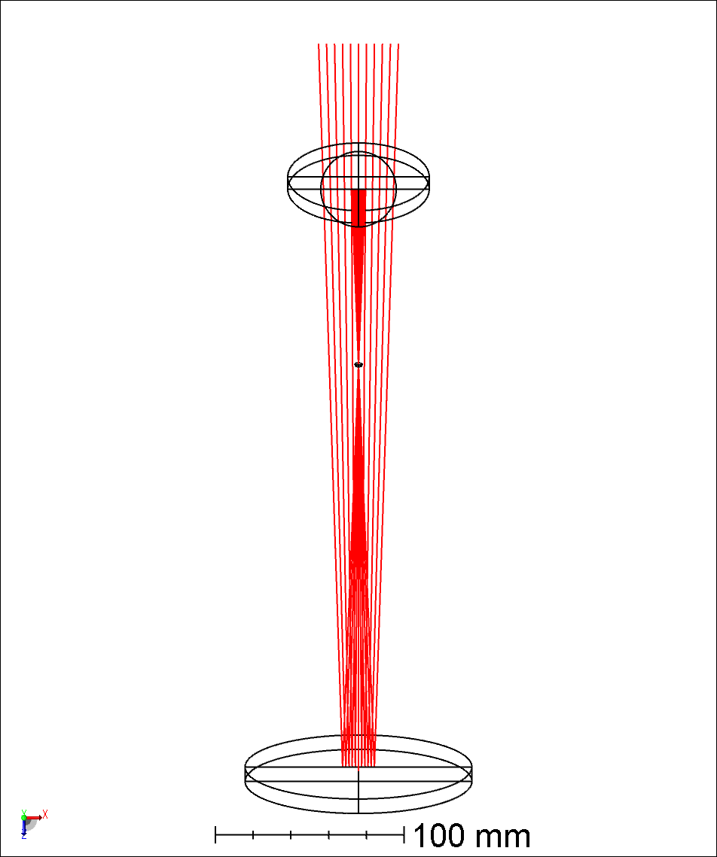
YZ Plane On-Axis Focus
YZ Plane
XZ Plane
Z-Piston
X-Tilt
± 10mm
3 DOF required
X-Tilt
MMT1.1 ARIES1.1 Stage2.8a.zmx

Slide 5
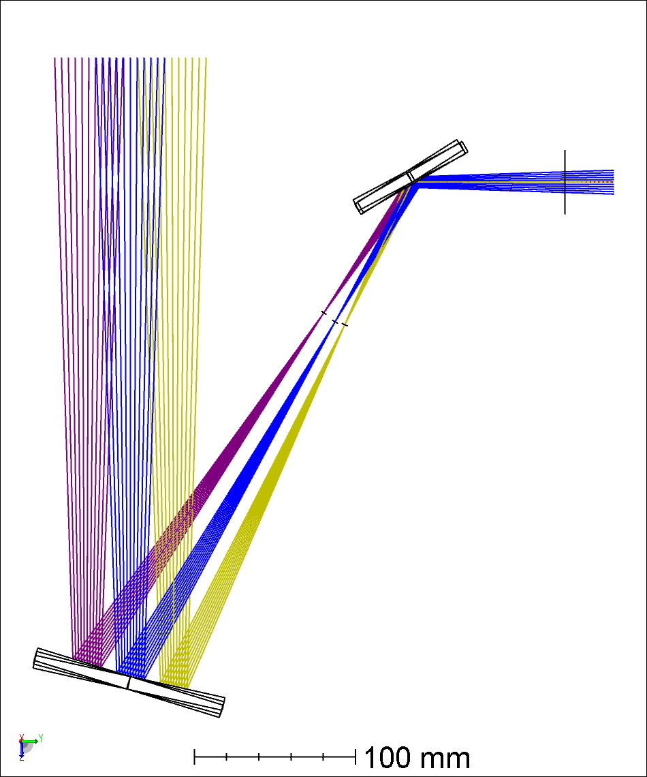

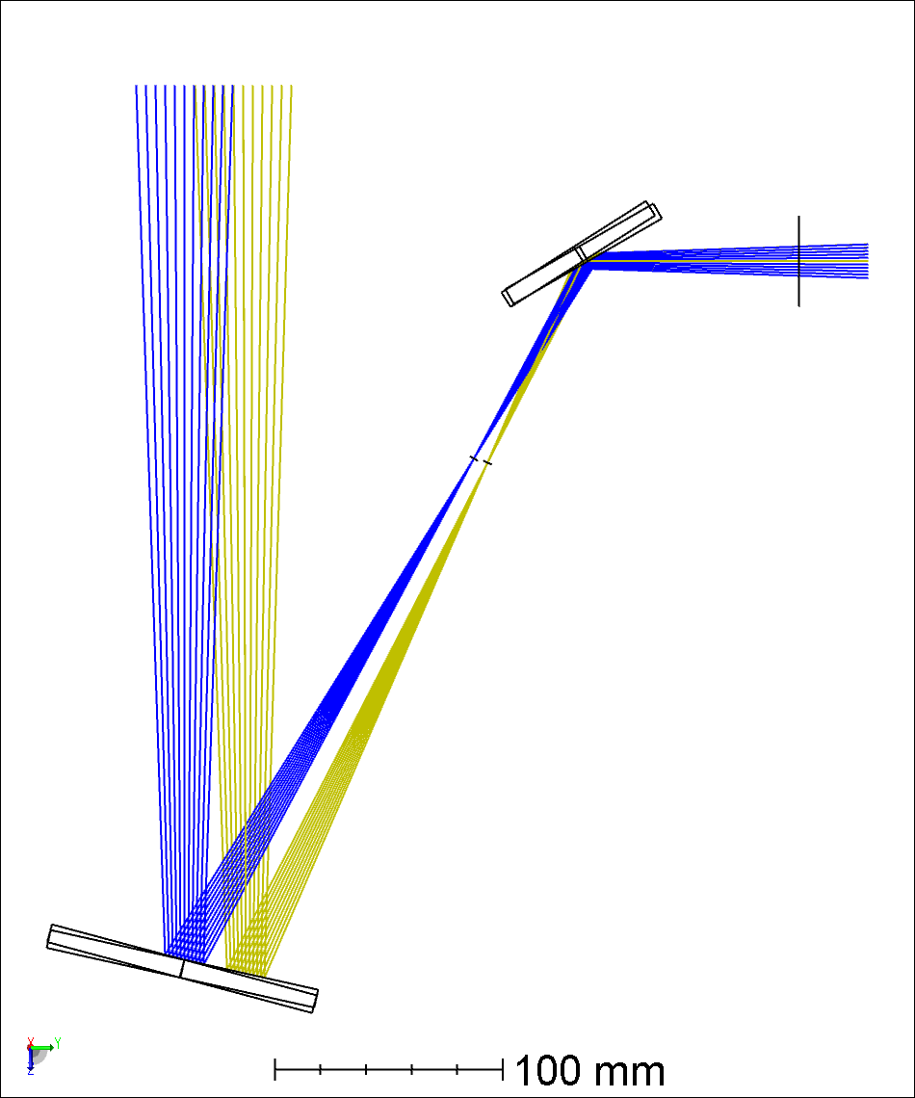
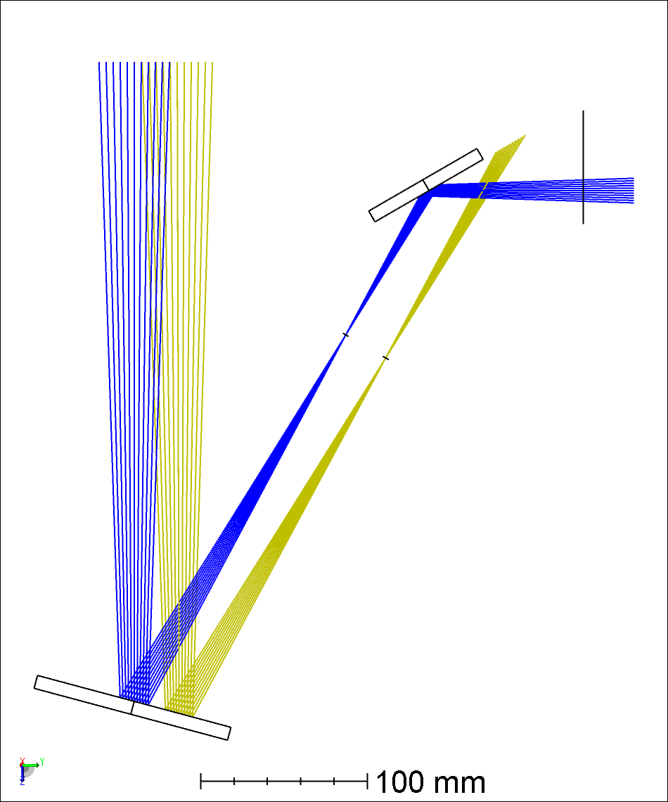
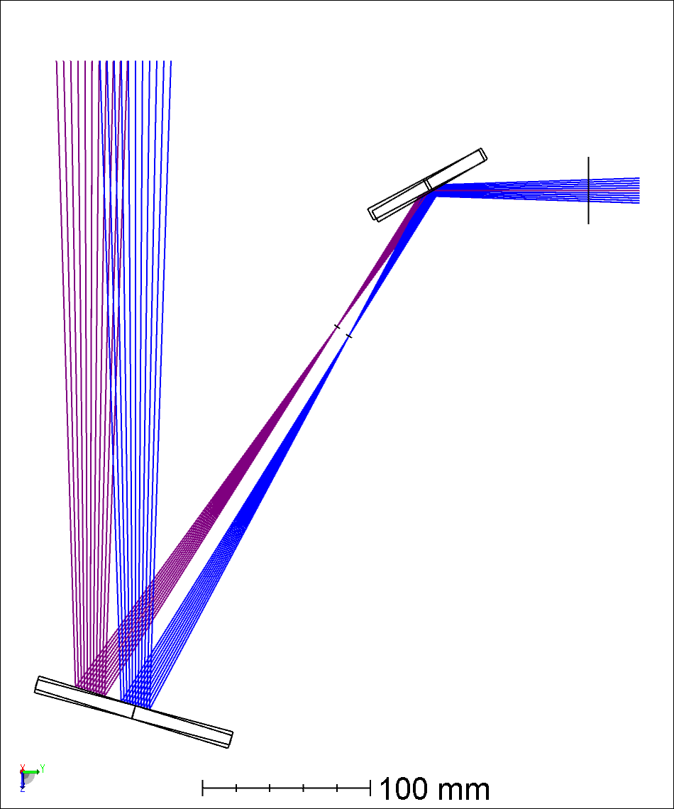
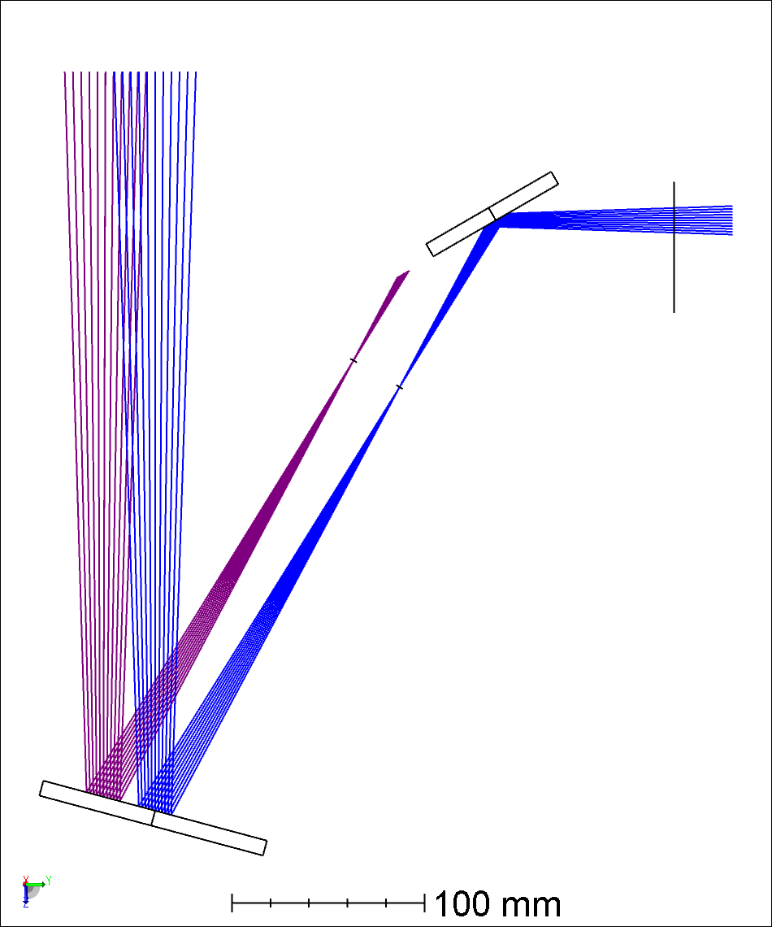
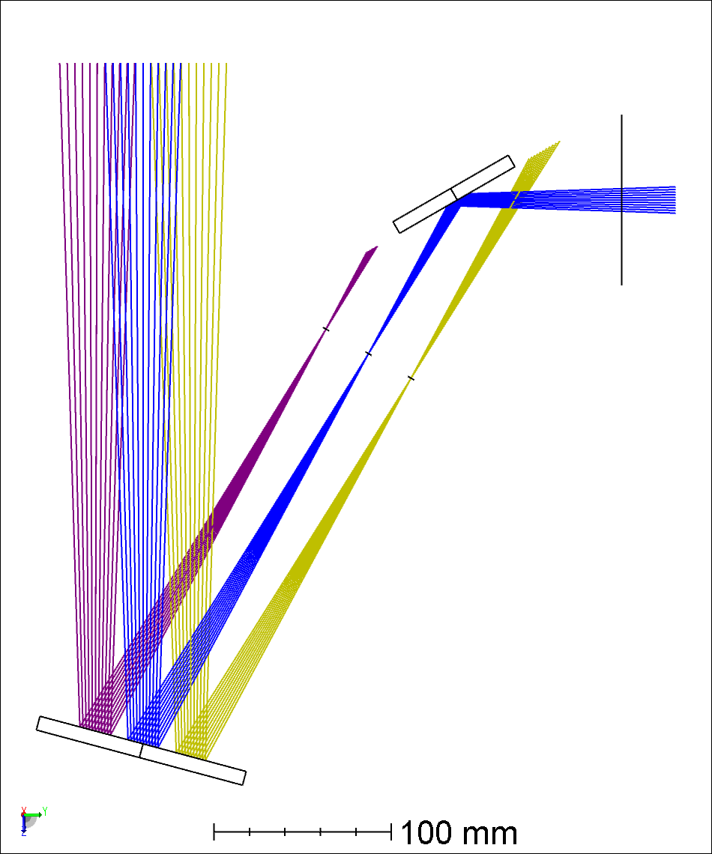
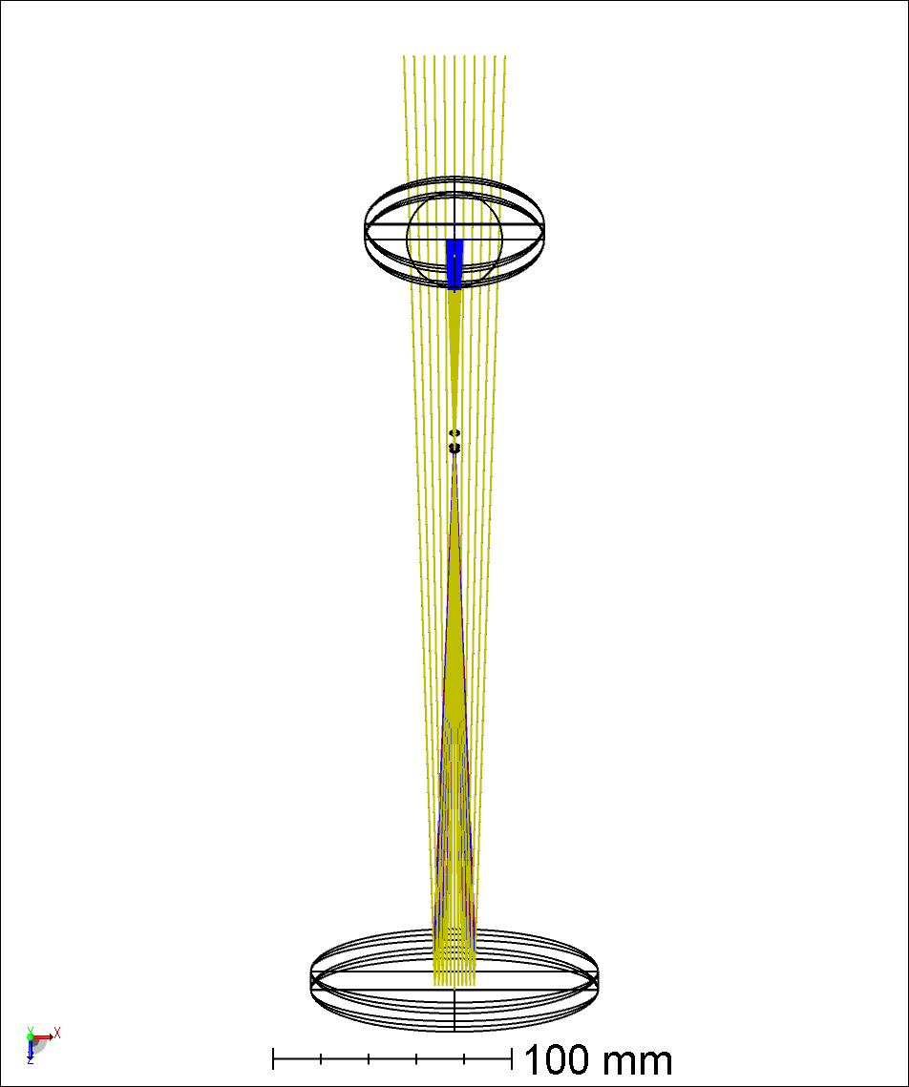
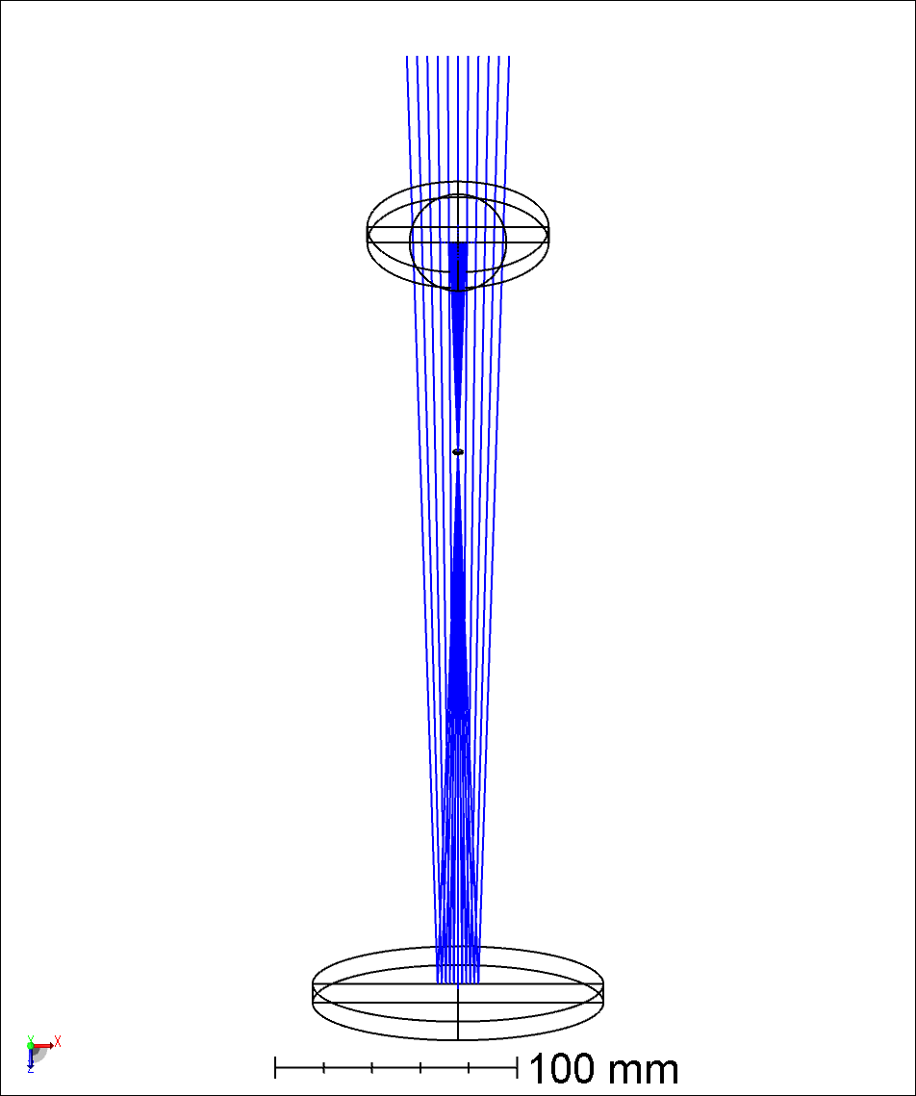
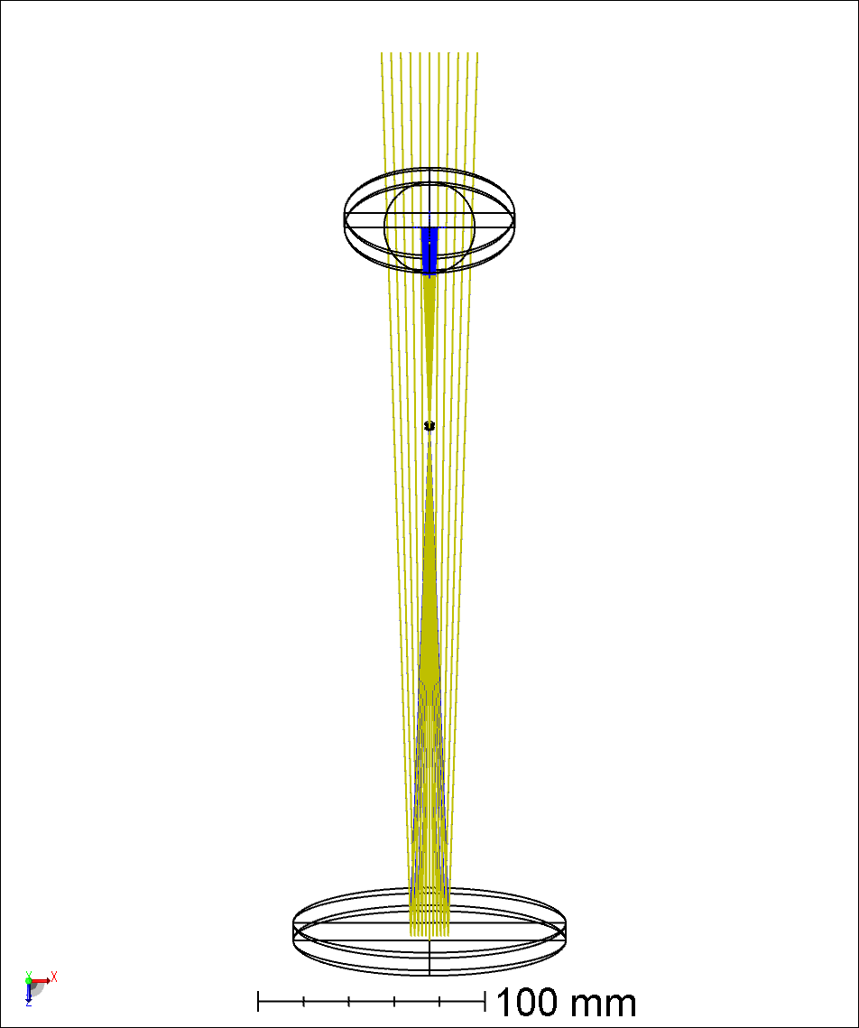
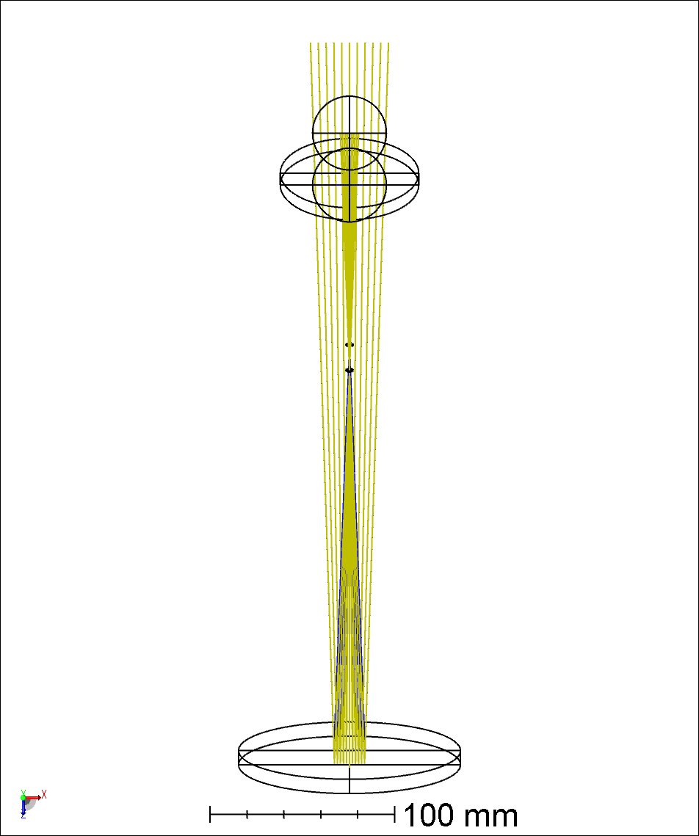
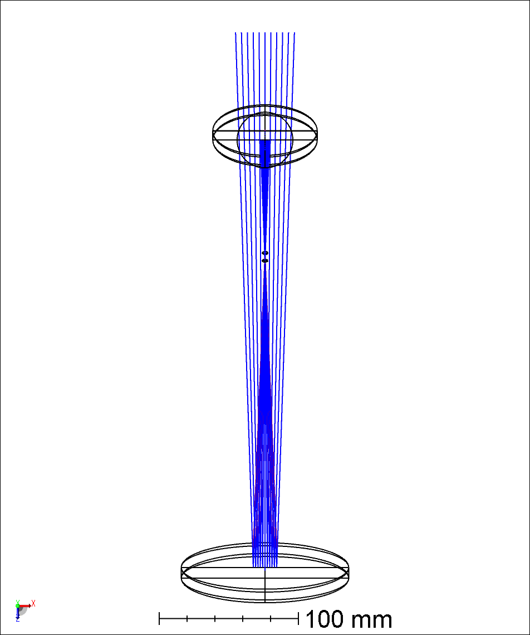
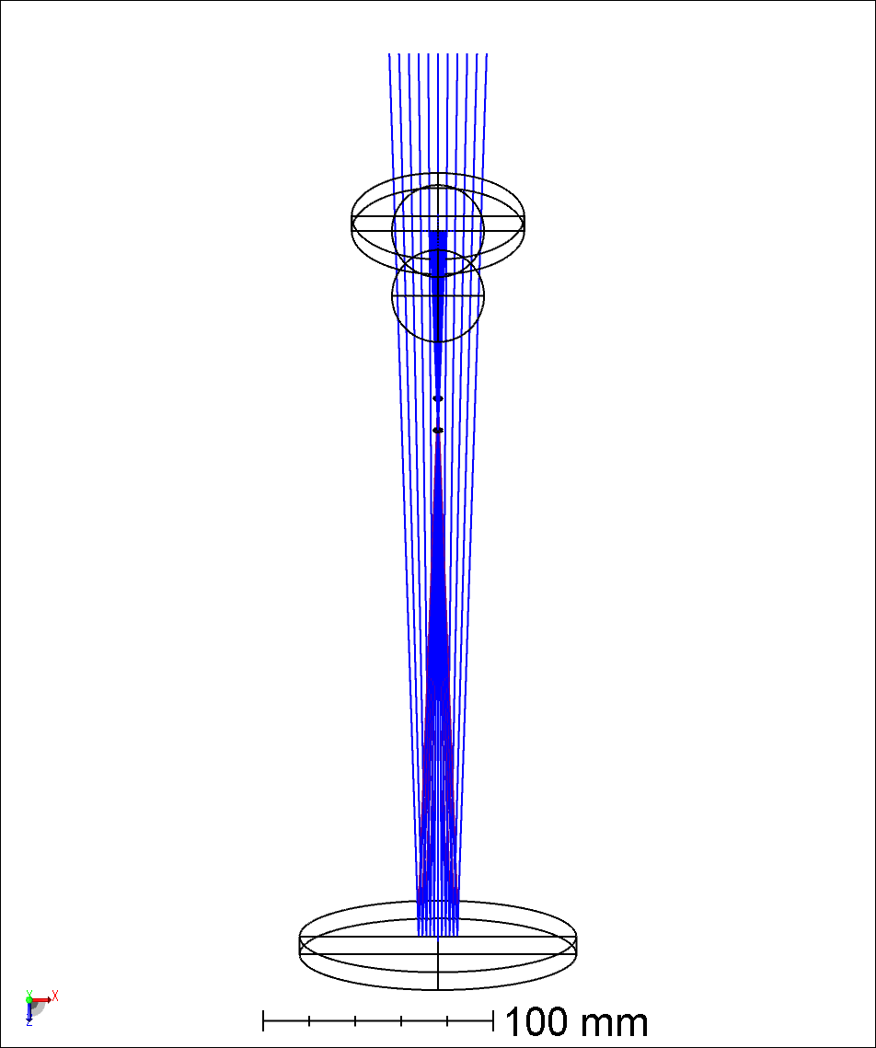
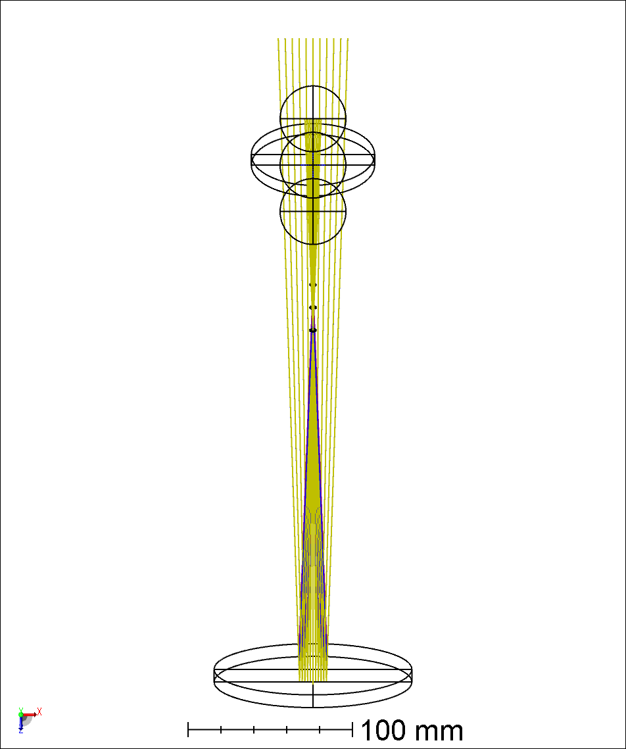
YZ Plane Boresight
YZ Plane
XZ Plane
X-Tilt
-1’
+1’
2 DOF required
X-Tilt
MMT1.1 ARIES1.1 Stage2.8a.zmx

Slide 6
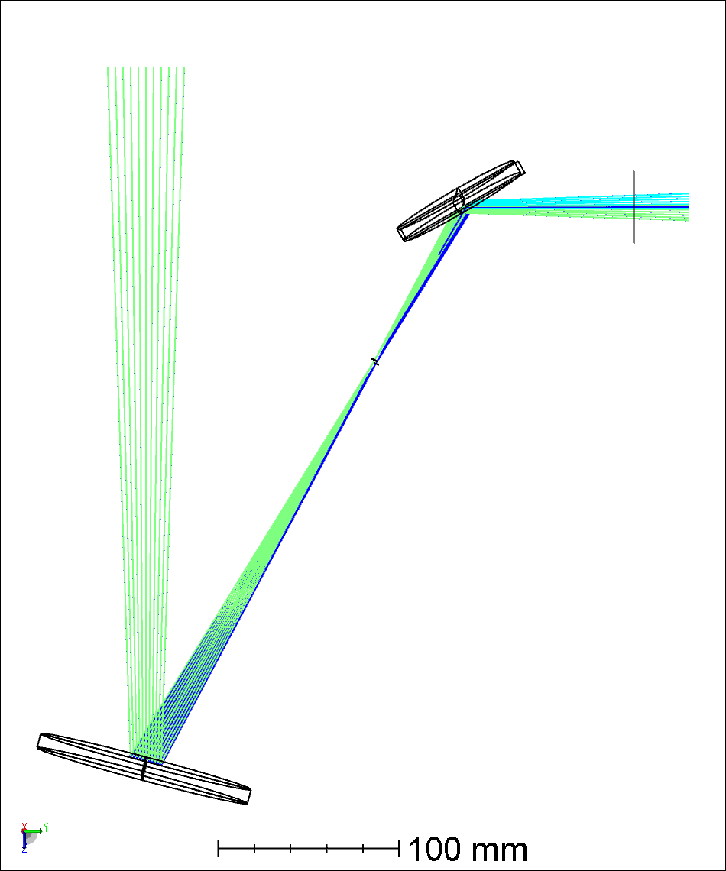

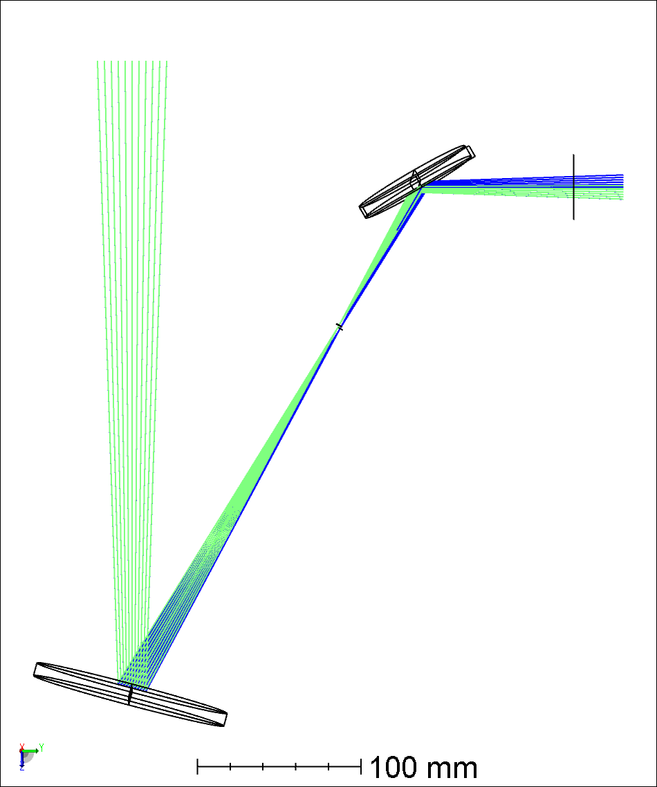
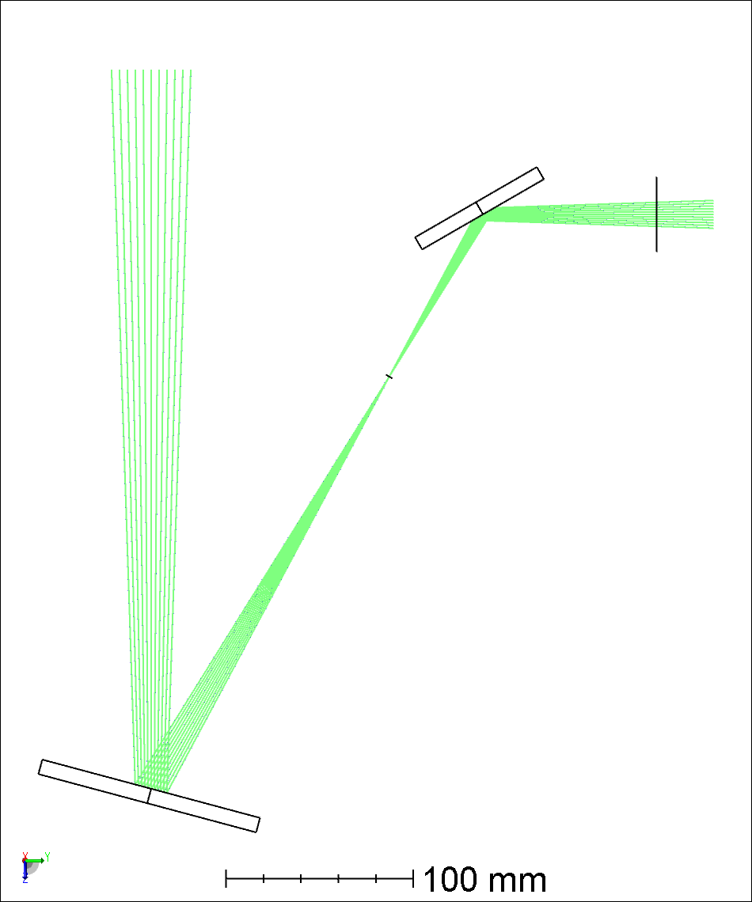
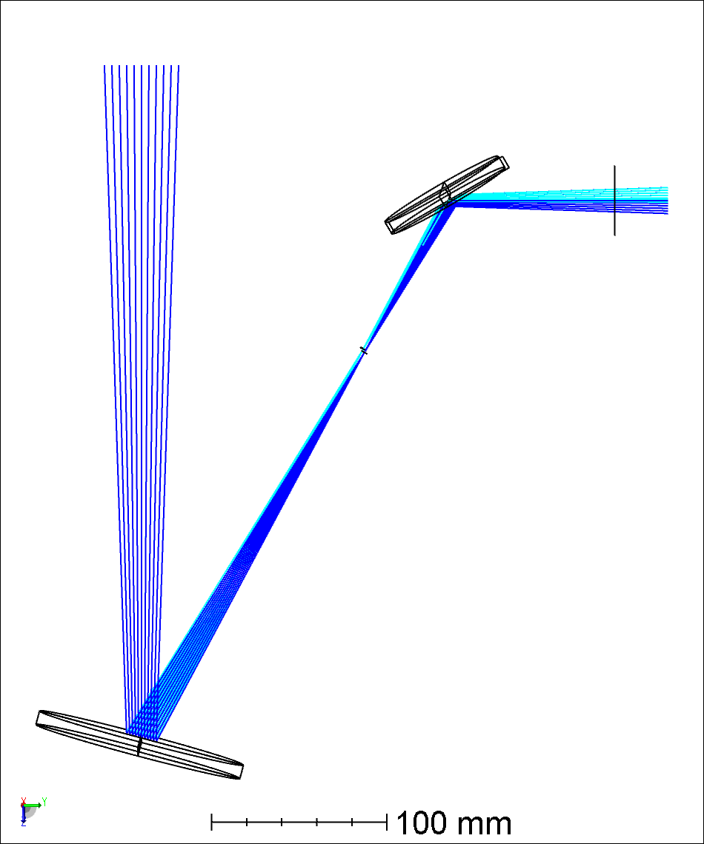
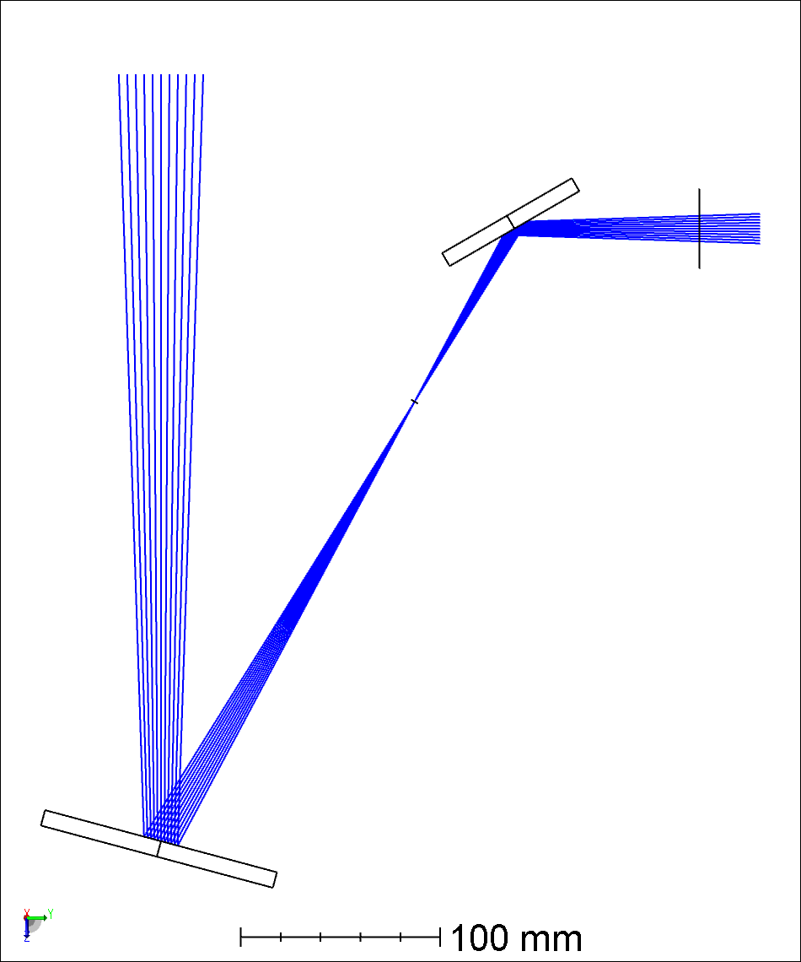

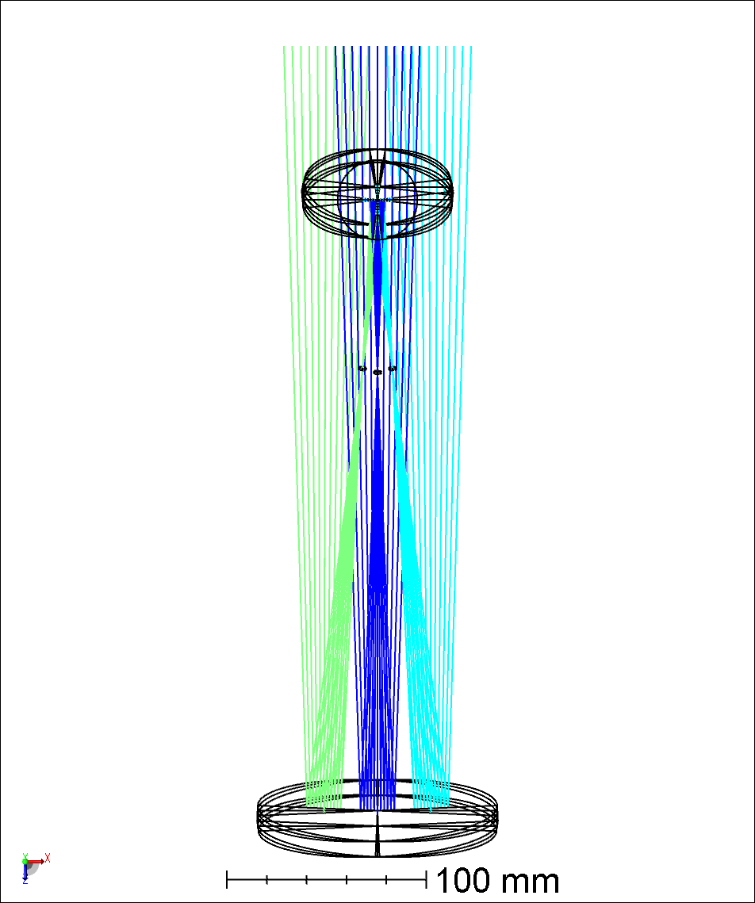

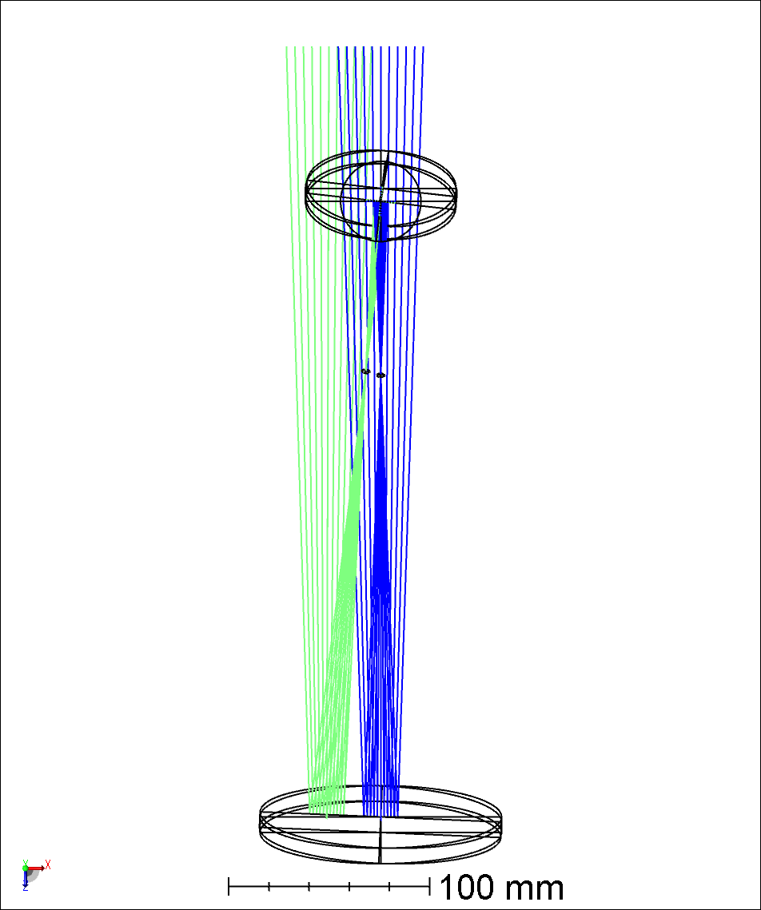
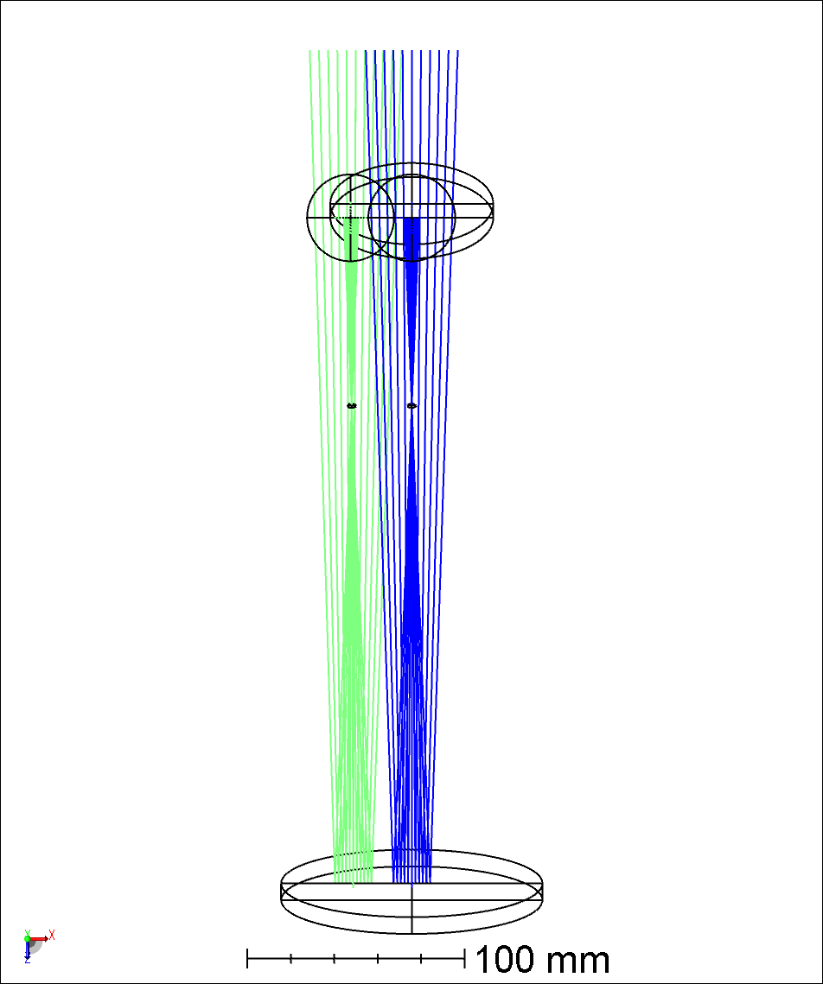
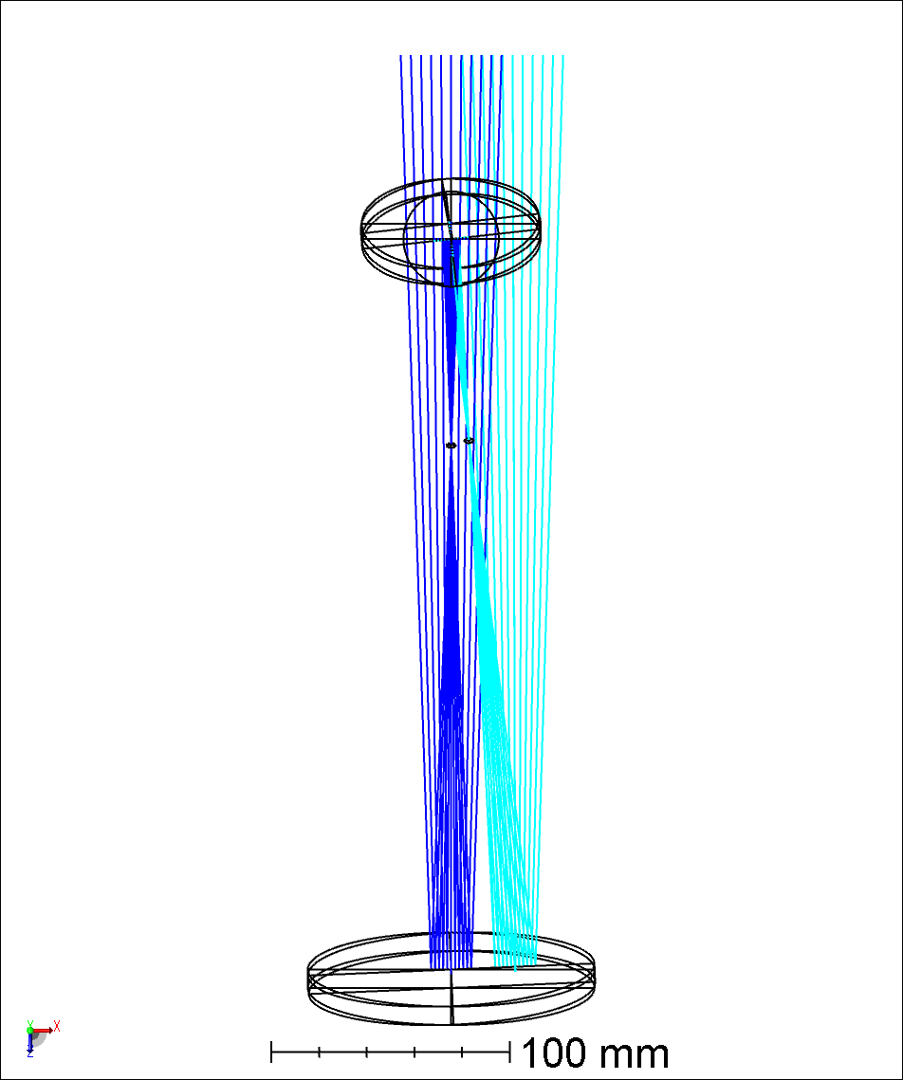
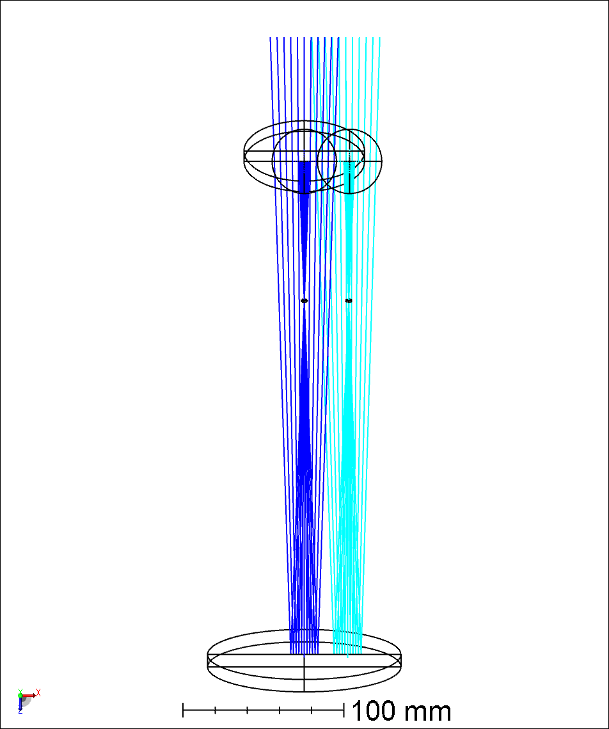
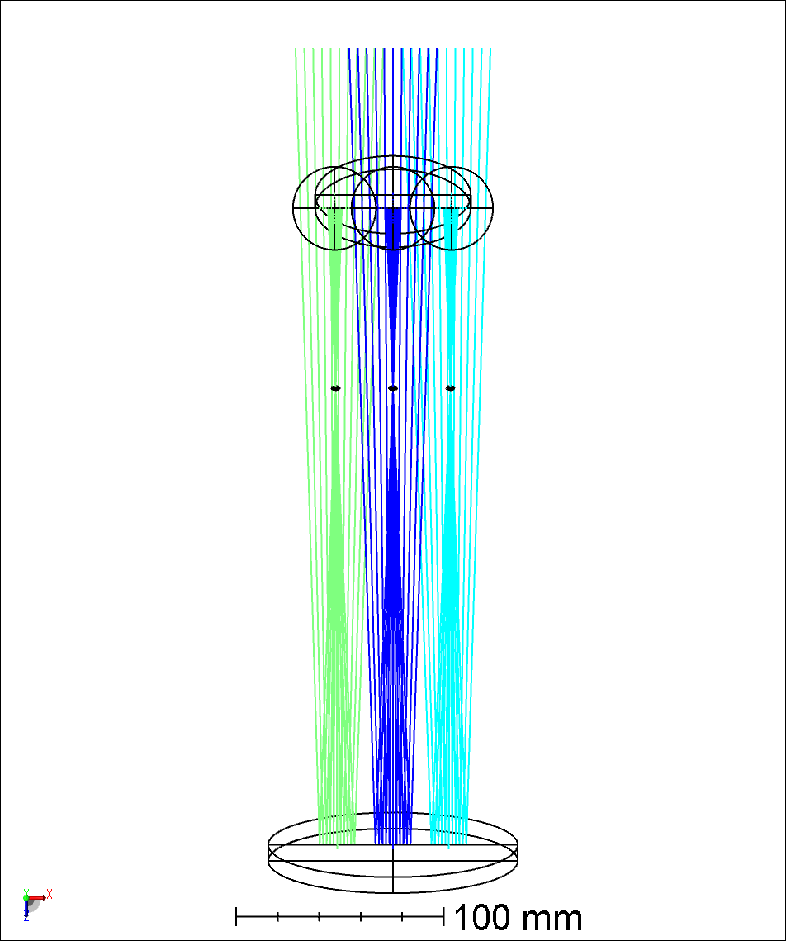
XZ Plane Boresight
YZ Plane
XZ Plane
Y-Tilt
-1’
+1’
2 DOF required
Y-Tilt
MMT1.1 ARIES1.1 Stage2.11a.zmx

Slide 7
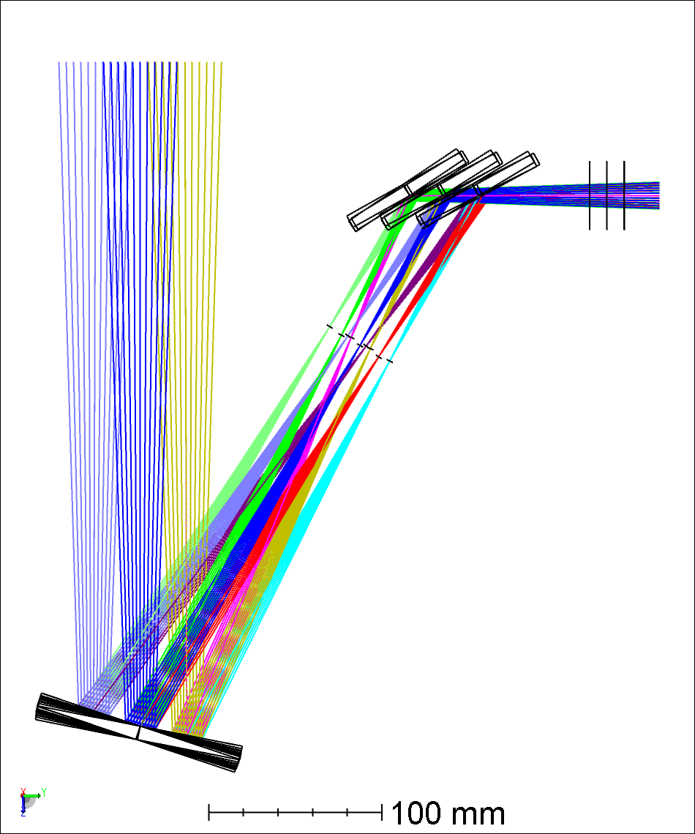
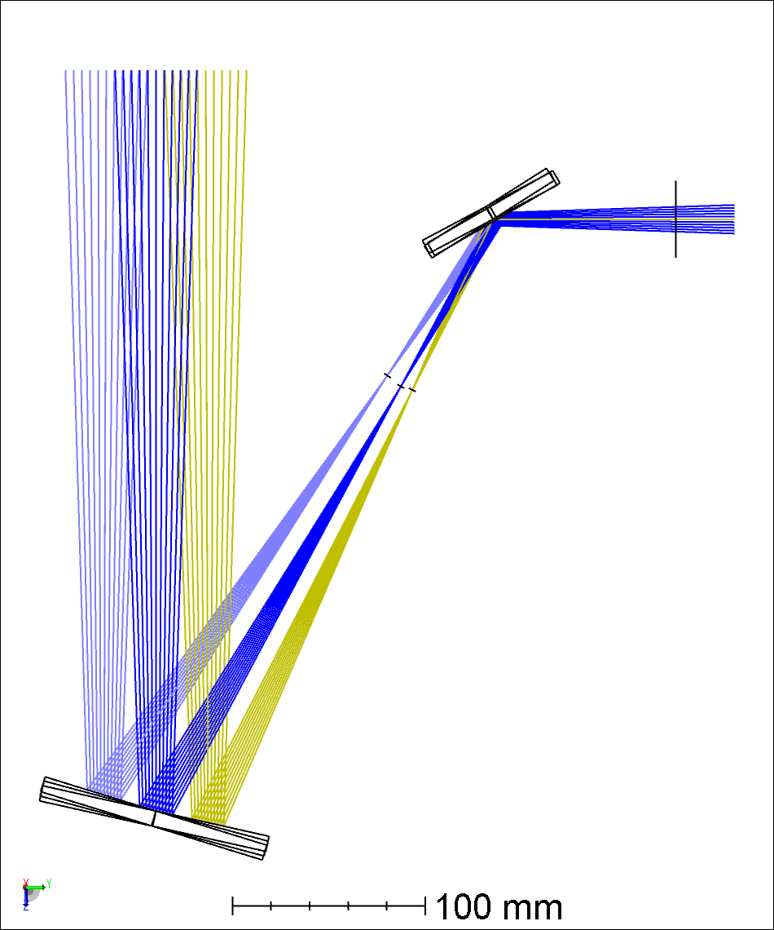
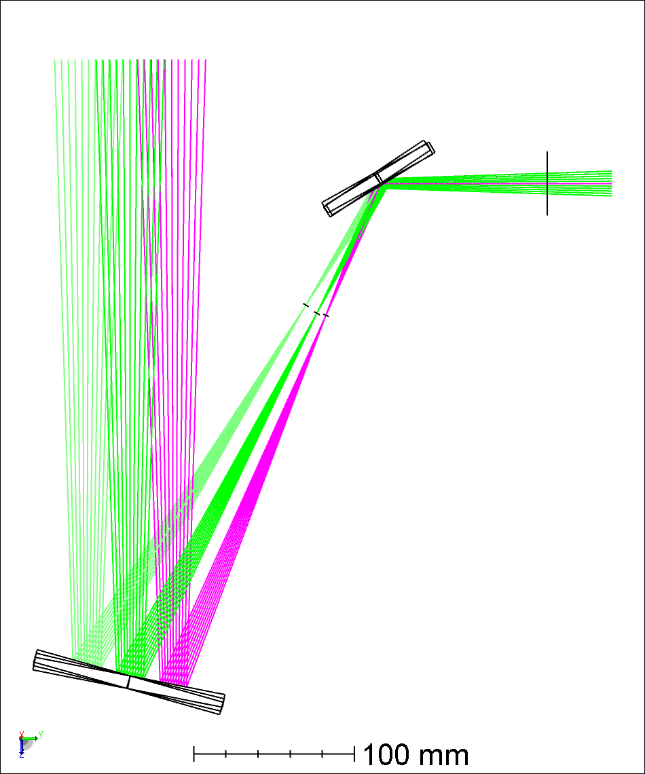
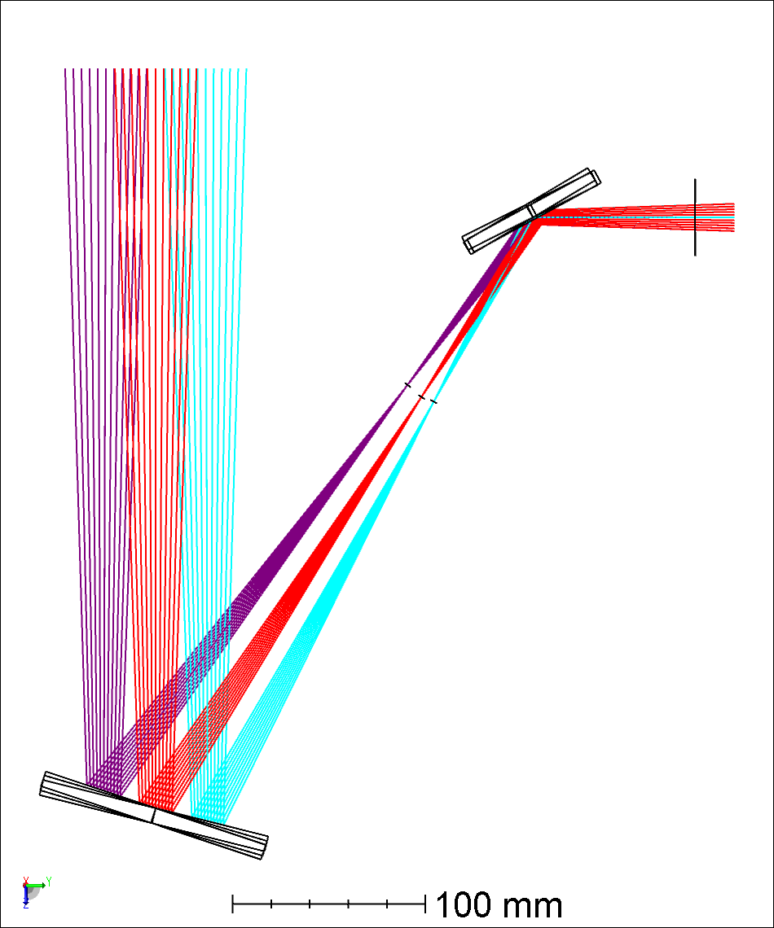
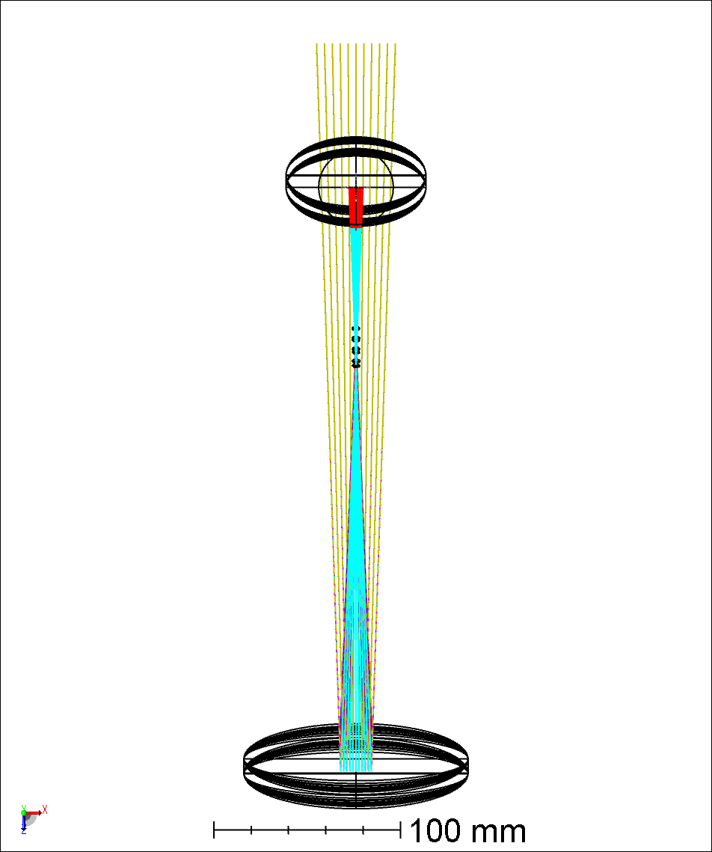
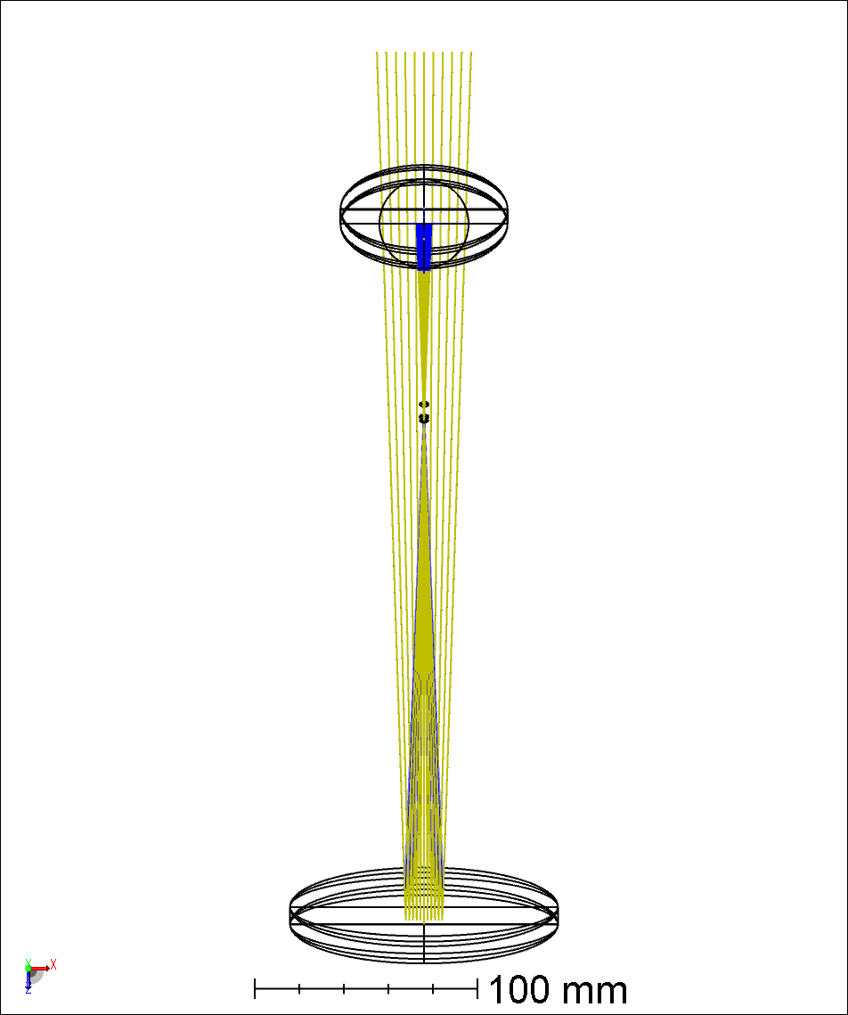
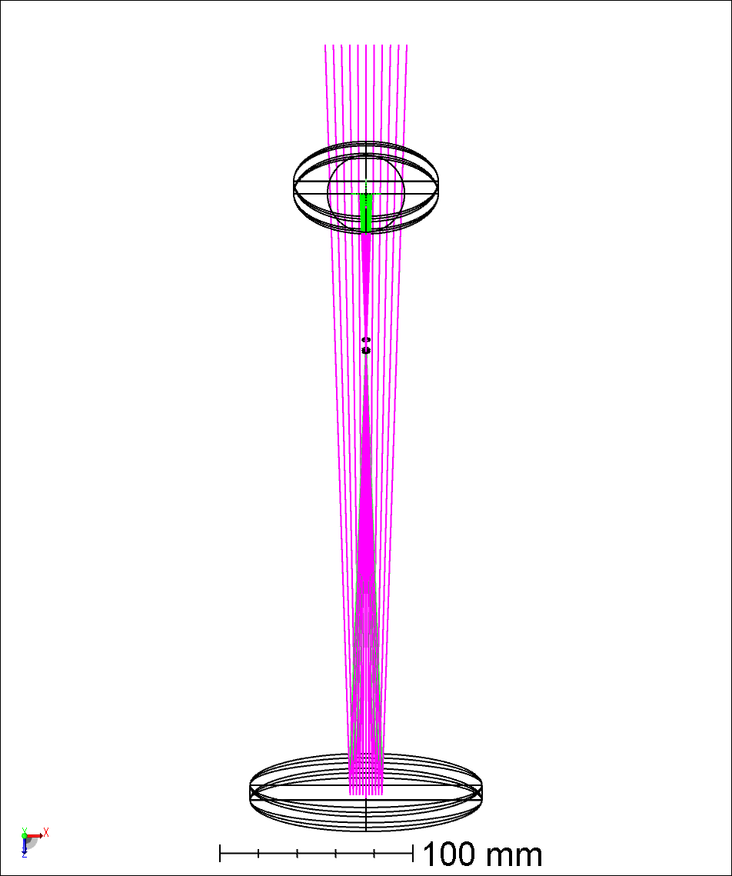
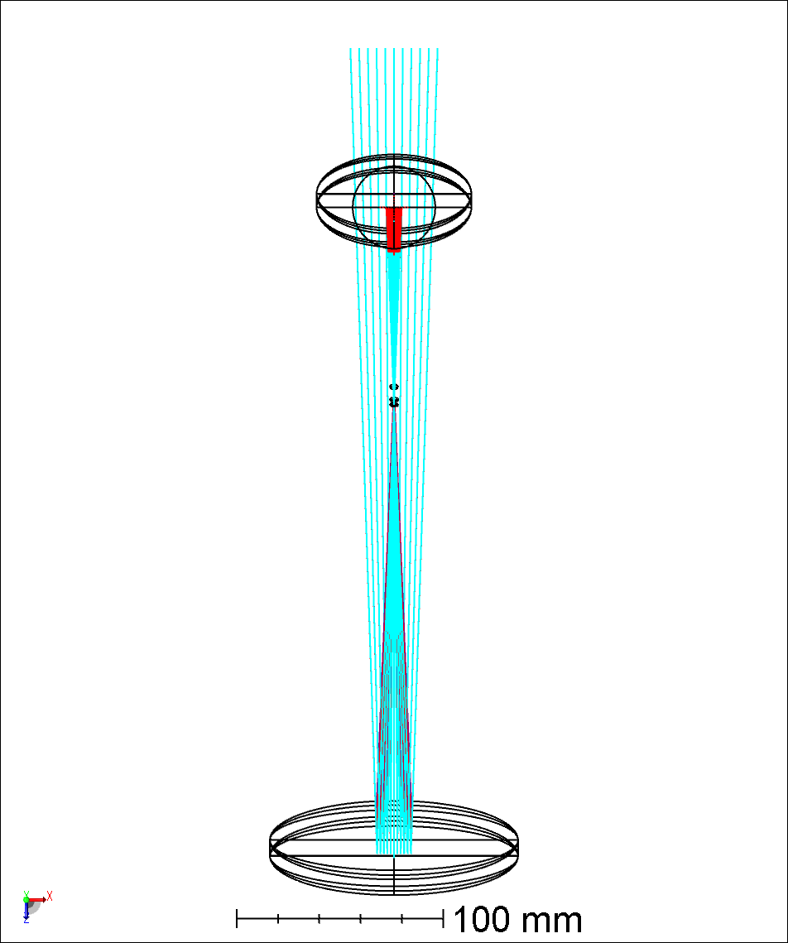
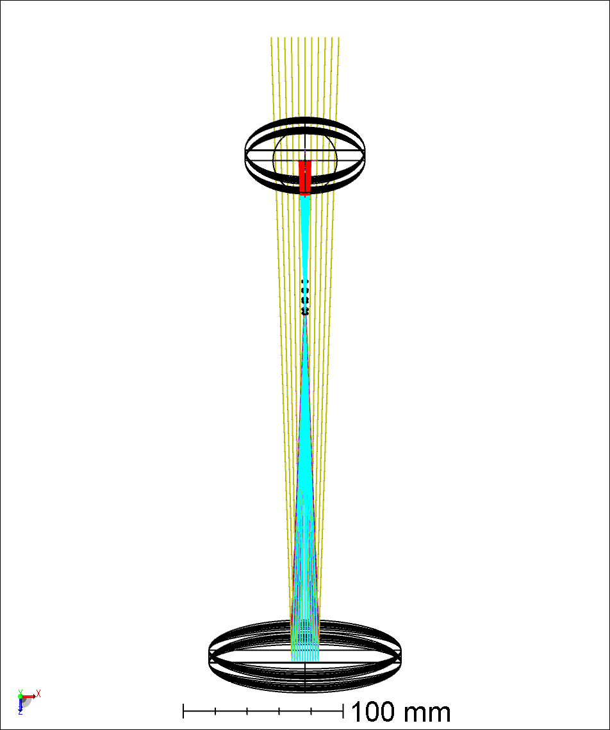
YZ-Plane Boresight & Focus
YZ Plane
XZ Plane
Z-Piston
X-Tilt
± 10mm
3 DOF required
X-Tilt
MMT1.1 ARIES1.1 Stage2.8a.zmx

Slide 8
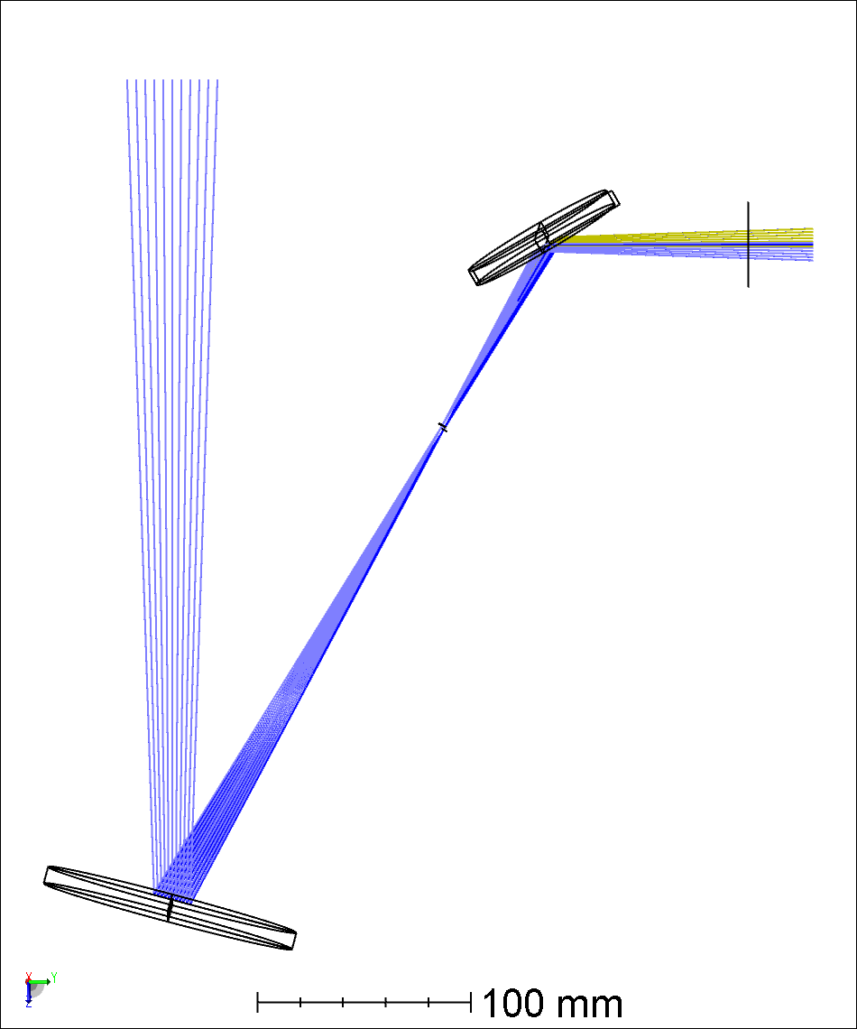
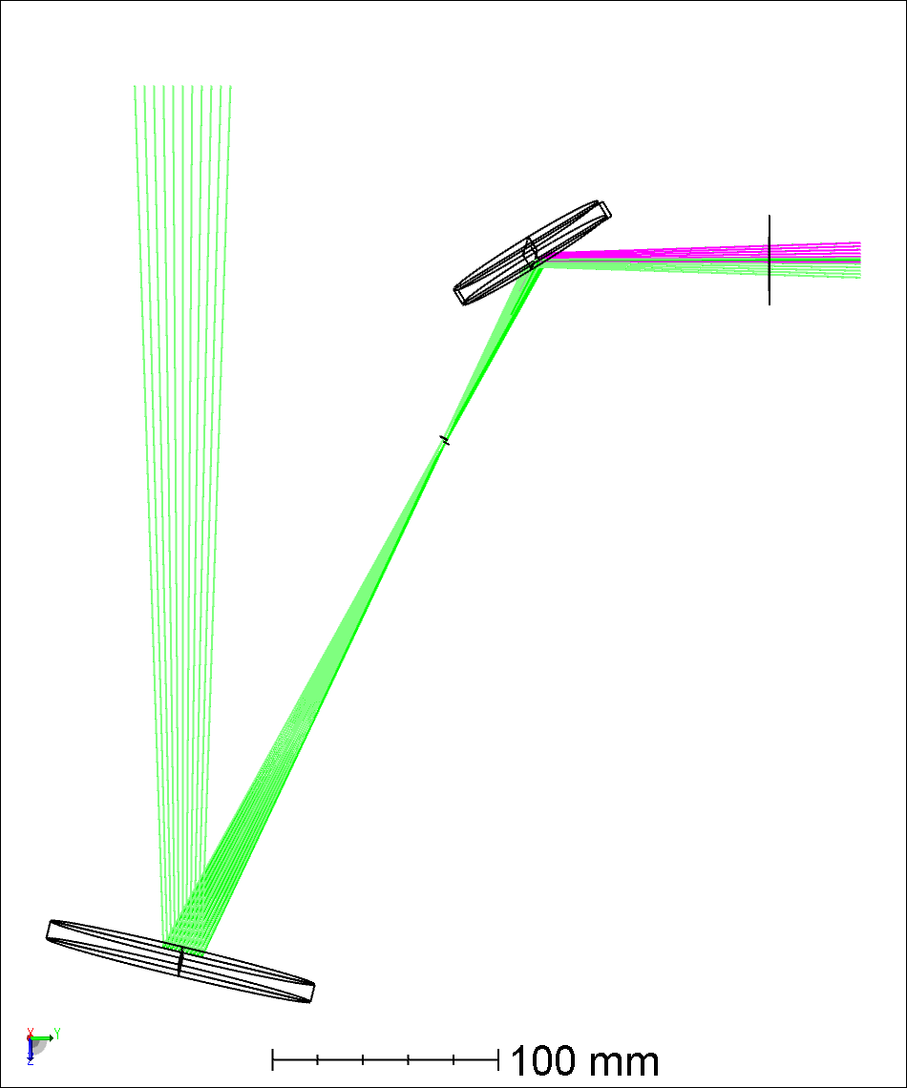
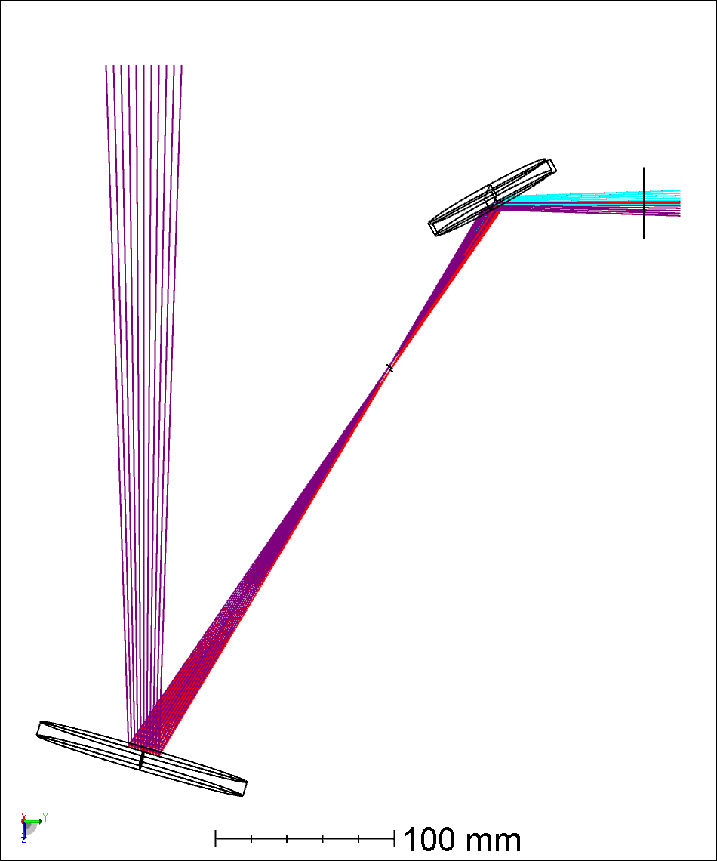
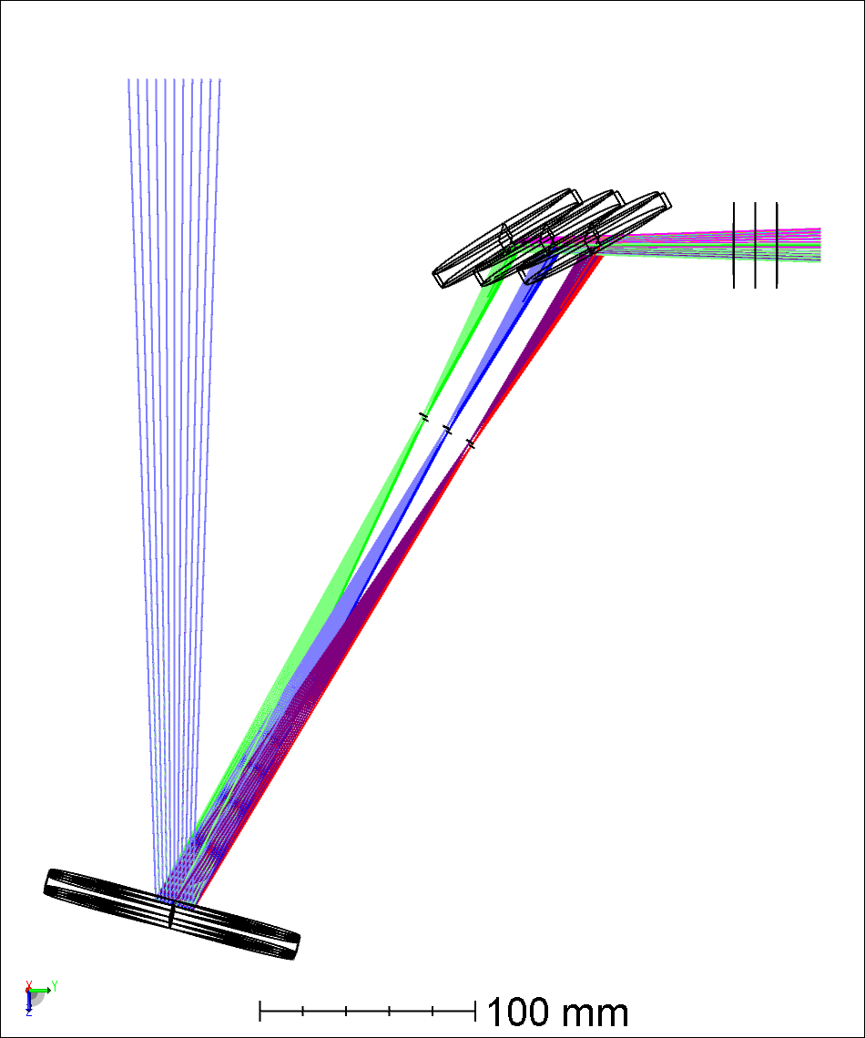
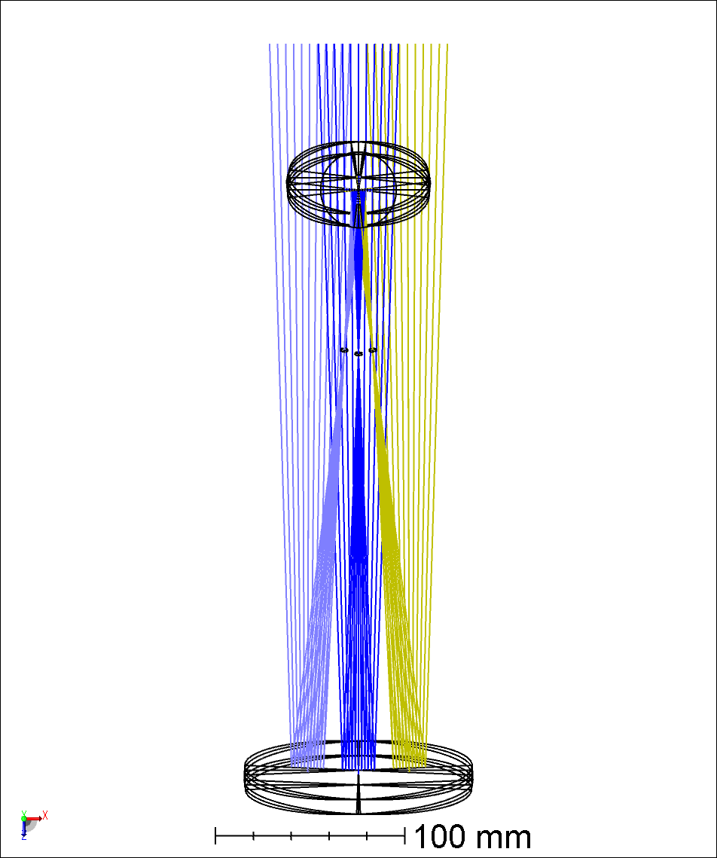
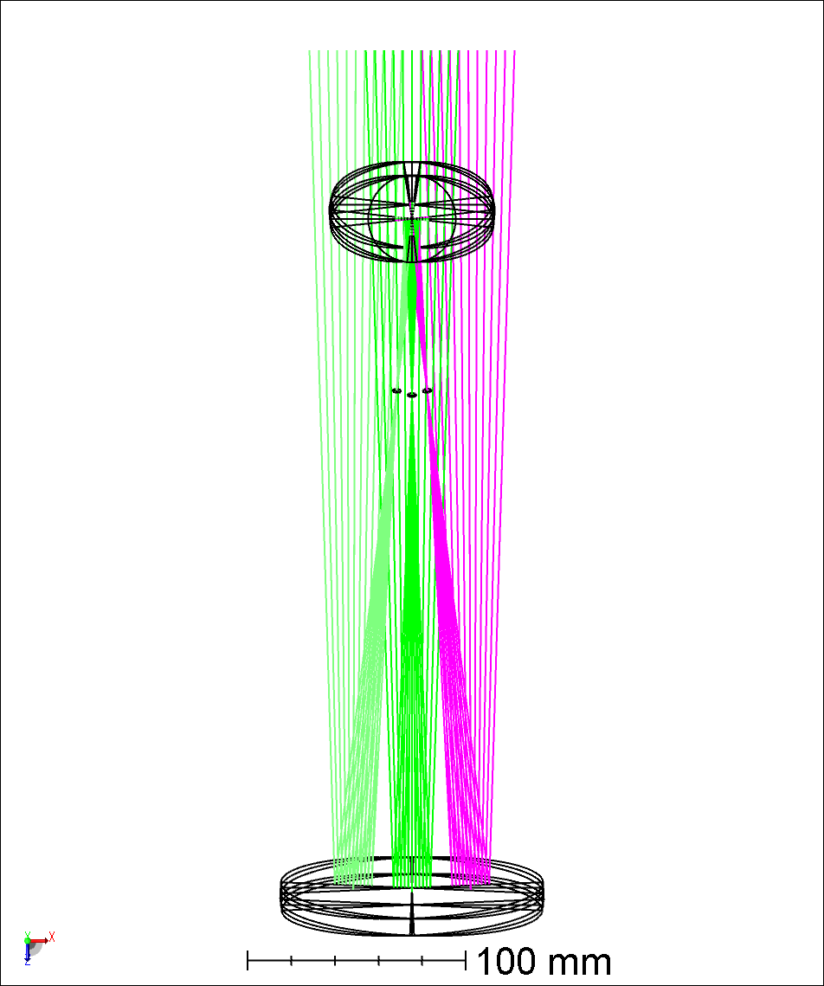
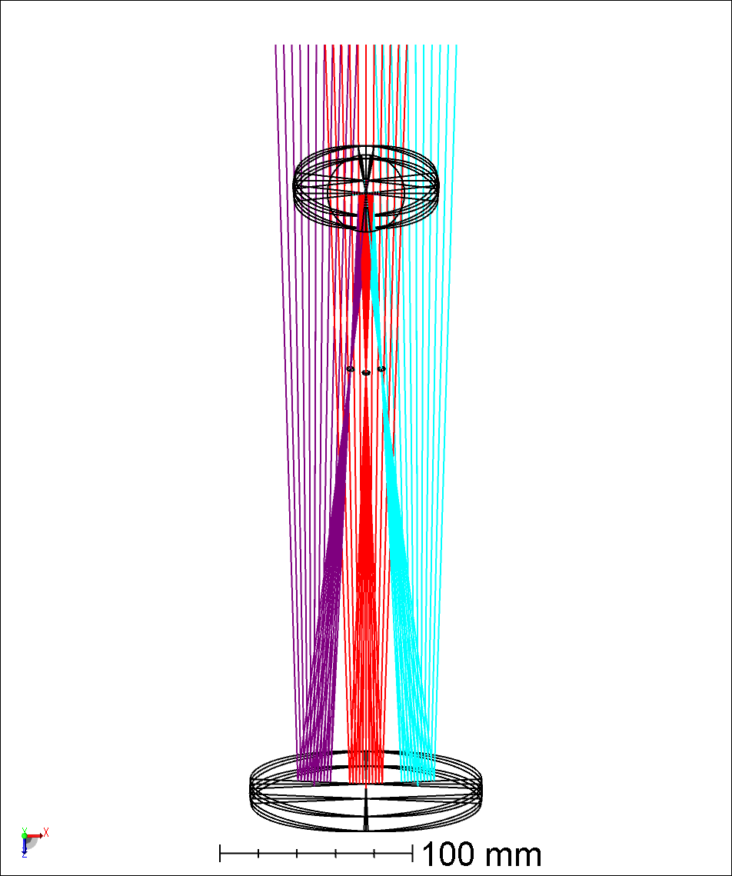
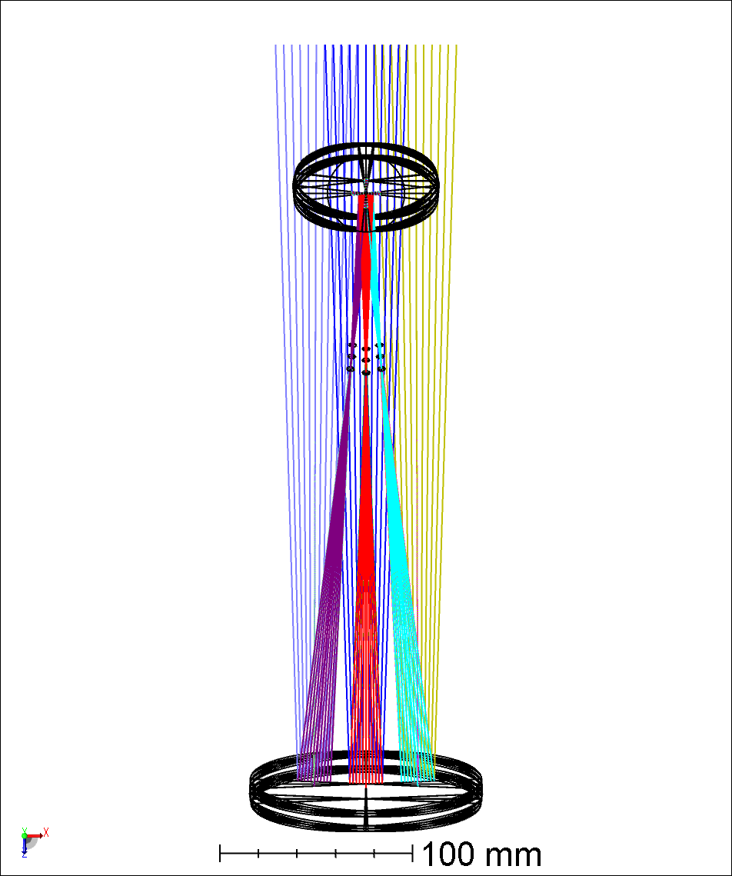
XZ-Plane Boresight & Focus
YZ Plane
XZ Plane
Z-Piston
X-Tilt
Y-Tilt
± 10mm
5 DOF required
X-Tilt
Y-Tilt
MMT1.1 ARIES1.1 Stage2.11a.zmx

Slide 9
Periscope DOF Specs
 | On-Axis | YZ Plane |  | XZ Plane |  | Specs
Alignment Type | Focus | Boresight | Boresight & Focus | Boresight | Boresight & Focus | -
DOF Required | 3 | 2 | 3 | 4 | 5 | 5
ARIES Dichroic X-Tilt [˚] | ± 1.4 | ± 2.4 | ± 3.9 | ± 0.2 | ± 1.5 | ± 3.9
ARIES Dichroic Y-Tilt [˚] | 0 | 0 | 0 | ± 2.4 | ± 2.5 | ± 2.5
Periscope Fold Mirror X-Tilt [˚] | ± 1.4 | ± 2.4 | ± 3.9 | ± 0.2 | ± 1.6 | ± 3.9
Periscope Fold Mirror Y-Tilt [˚] | 0 | 0 | 0 | ± 2.4 | ± 2.4 | ± 2.4
Periscope Fold Mirror Piston [mm] | ± 10 | 0 | ± 10 | 0 | ± 10 | ± 10

Slide 10

ACQ Channel FOV
3” Periscope Fold Mirror
+10” FOV
On-axis
-10” FOV
f/15 Focal Plane
ARIES Dichroic
MMT1.1 ARIES1.1 Stage2.5.zmx

Slide 11

Unfolded WFS Design
DCC3240N
ACQ Channel
Periscope
f/15 FP
ITL
BS
Modulator
Periscope Fold Mirror
ADC
Telescope Dichroic
Baseline
K-Mirror
Flip Mirror
Double Pyramid
CTL
CCID75
VPWFS Channel
IRPWFS Channel
Double Pyramid
Saphira
CTL
Base1.8 VPWFS4.7 IRPWFS1.3.2 ACQ2.4 Int5.3.zmx

Slide 12

Top Box Shaded Model
Base1.8 VPWFS4.7 IRPWFS1.3.2 ACQ2.4 Int5.3.zmx

Slide 13

Does It Fit?
Top Box Floor
DCC3240N
ARIES Dichroic
64” (1625.6 mm)
CCID75
Periscope Fold Mirror
Saphira Cryostat
Base1.8 VPWFS4.7 IRPWFS1.3.2 ACQ2.4 Int5.3.zmx

